Slide 1
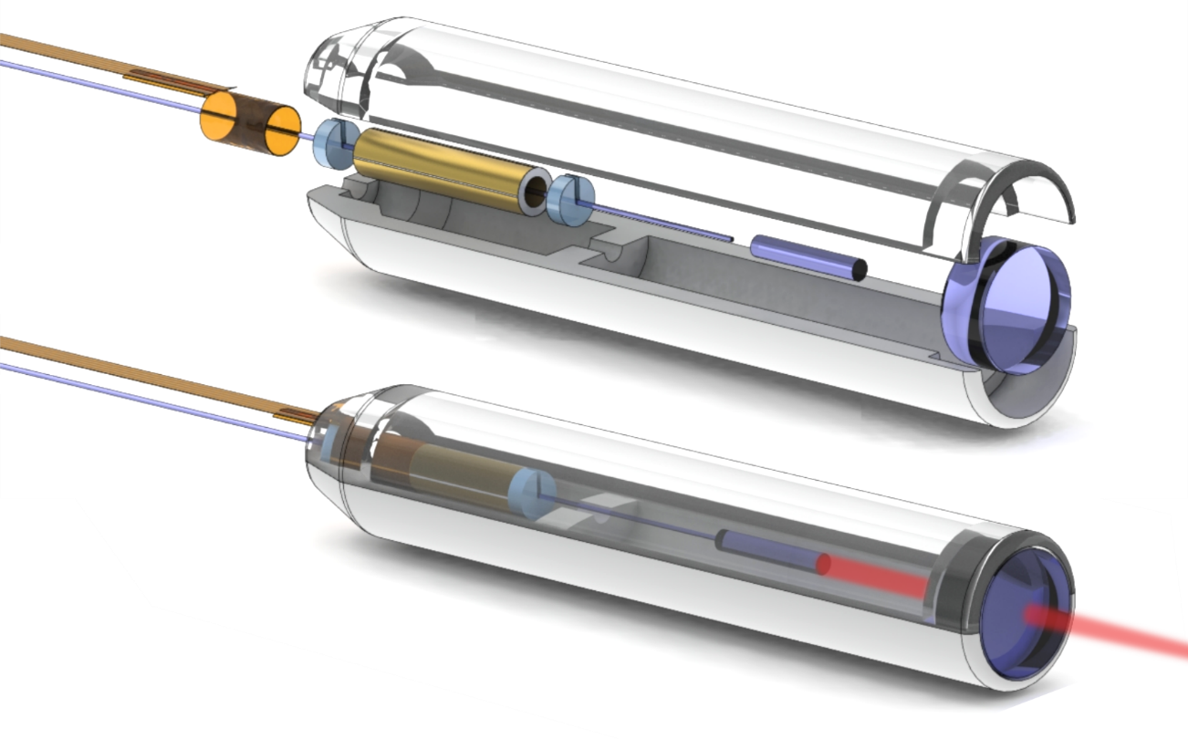
Compact OCT scanner for a bimodal endoscopic probe
Sergio Vilches
Notes:
[Keep whole laser beam]

Slide 2
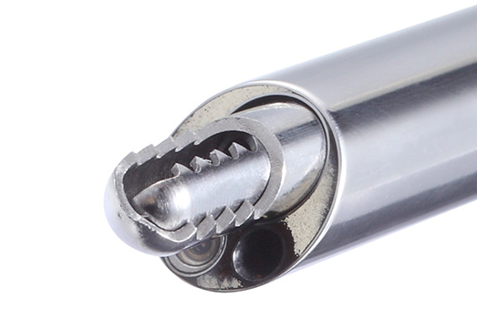
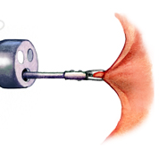
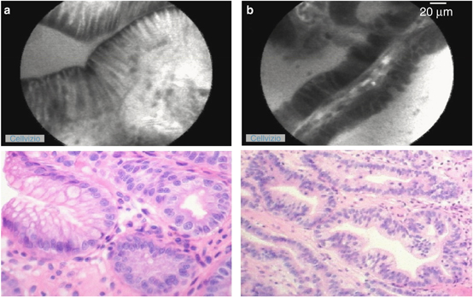
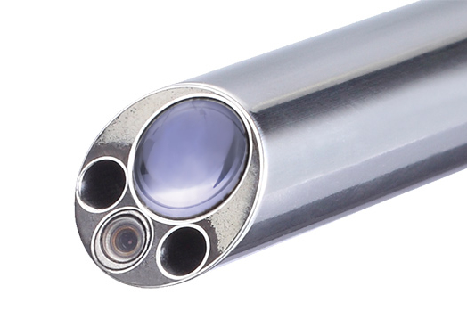
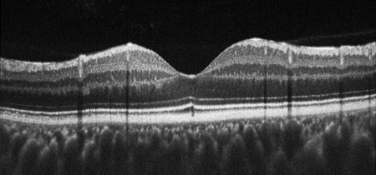
Motivation Optical biopsy
Conventional biopsy (ex situ)
Biopsy
Histology
Diagnostic
Arteriovenous Malformation Fujii T. Kuwano H.
Transversal OCT image of the macula J. A. Flatter and J. Carroll,
http://colorectalsurgeonssydney.com.au/?page_id=425
joimax GmbH
Optical biopsy (in situ)
Microscopy
OCT
Diagnostic
Notes:
Motivation: use several imaging modalities to improve diagnostic
Proposed endoscope head 13x2x3mm3
Aim of thesis: OCT modality
-> Review theory of OCT

Slide 3
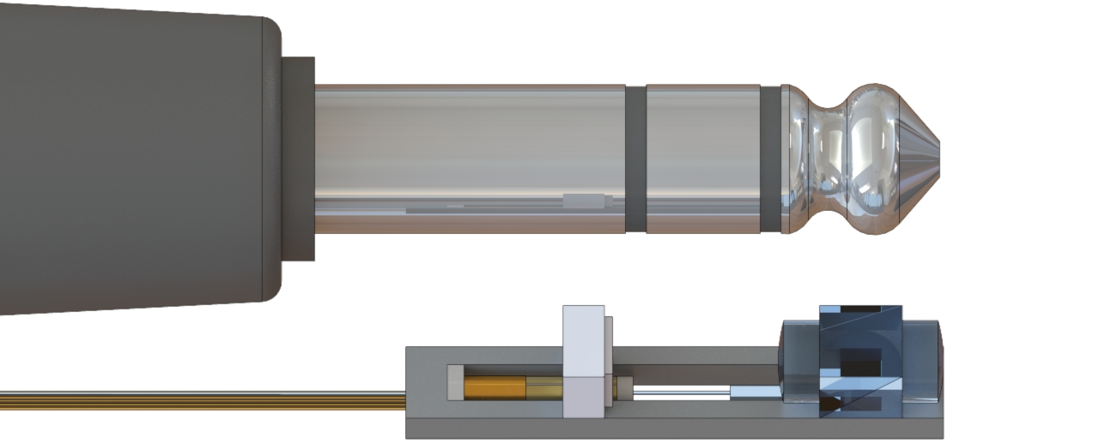

Fiber scanner Bimodal implementation: Size
$$13×2×3 {\text{mm}}^{3}$$
Notes:
Get an intuition of the size

Slide 4
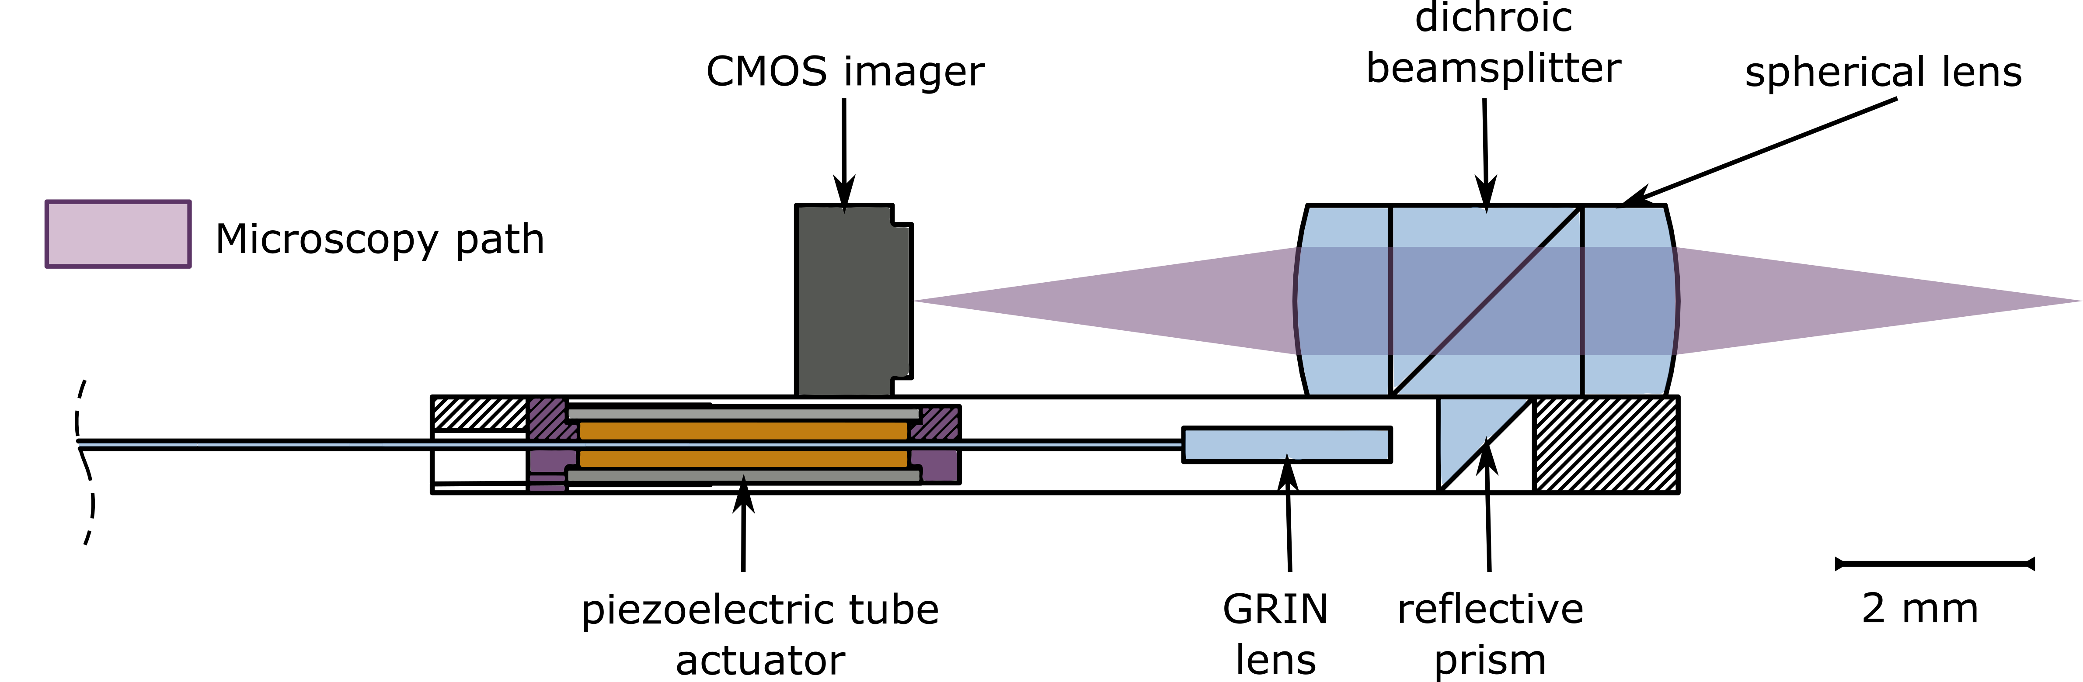
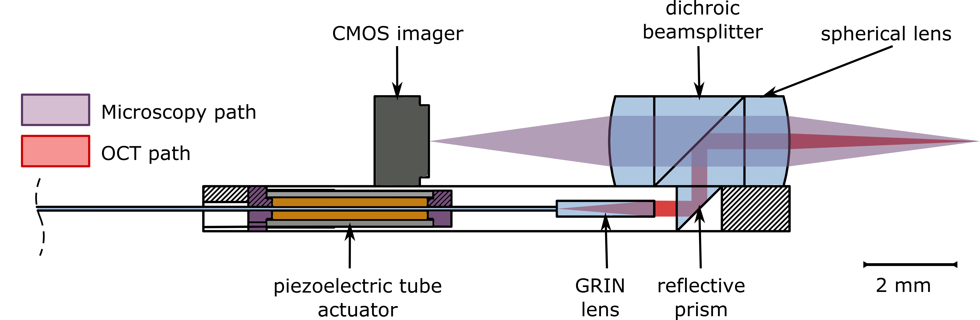
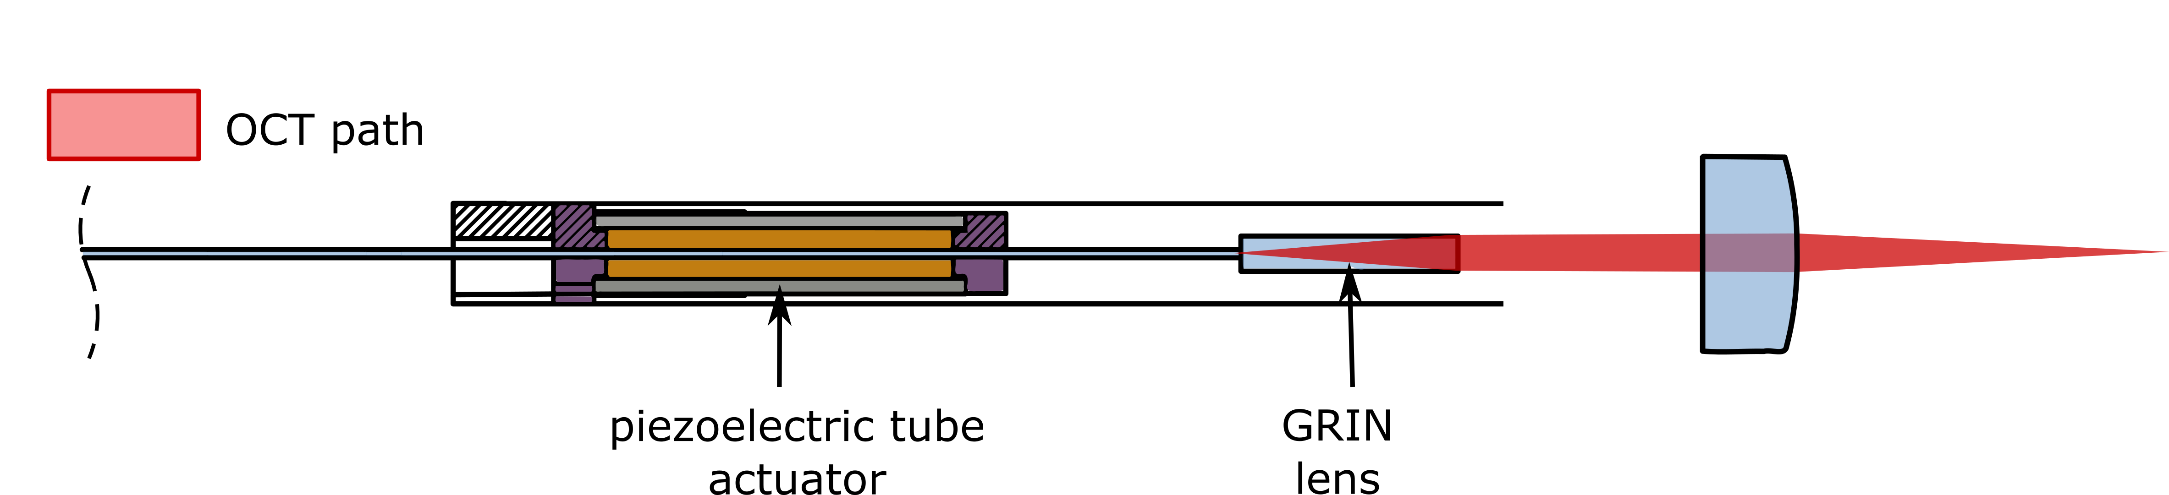
Fiber scanner Bimodal implementation
Notes:
Proposed implementation of bimodal probe
2 layer design
Independent beampaths, combined by dichroic beamsplitter
Ensure registration of both fields
System size of headphone jack
-> Analyze scanning engine, unfold the path

Slide 5
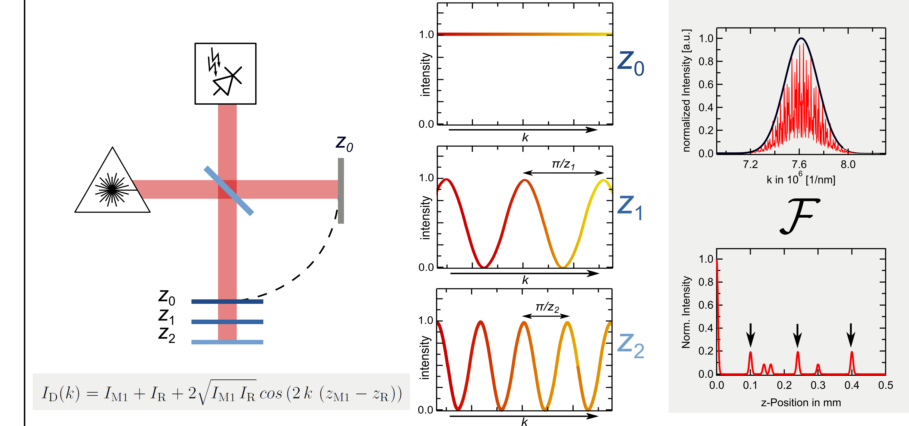
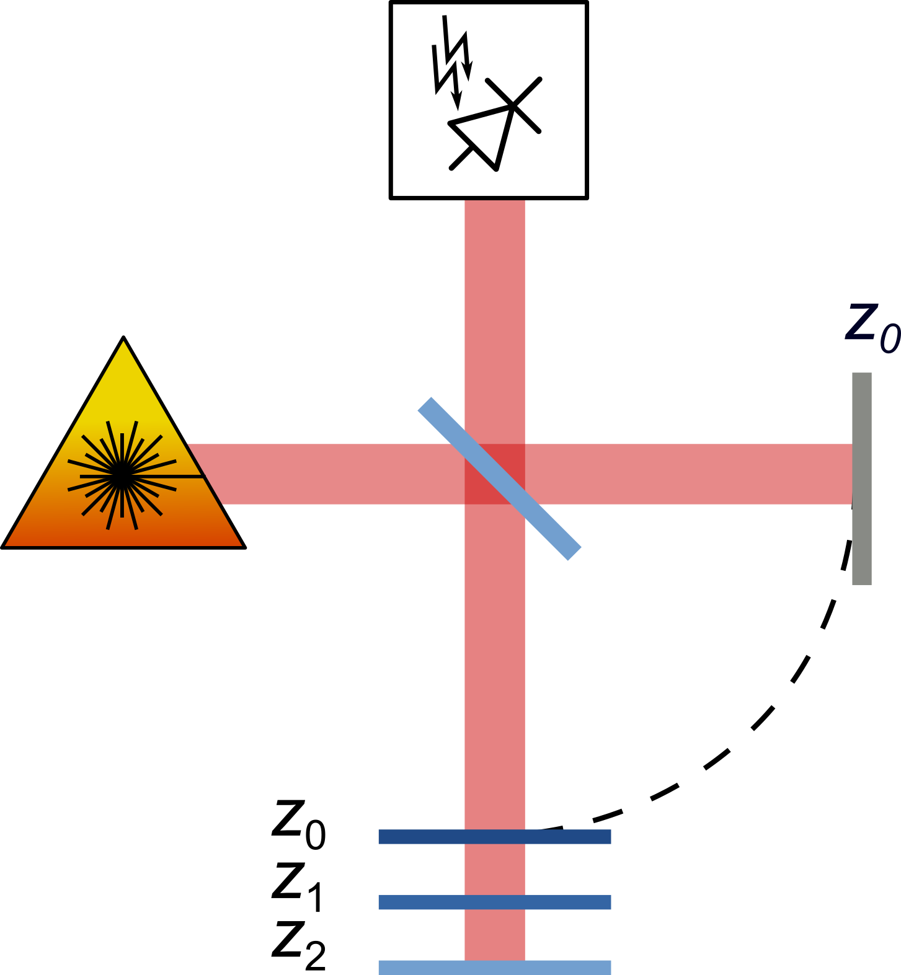
Swept-Source Optical Coherence Tomography SS-OCT Theory
Michelson interferometer
Spectrogram
Fourier transform
reference
mirror
sample
Notes:
What is SS-OCT?
Technique to measure depth information of a sample by analyzing its backscattered light.
Michelson interferometer with a laser which can sweep its wavenumber.
Intuitive explanation: Imagine reflector in sample arm
If placed at same distance as reference arm: constructive interference at all wavelengths
If placed at z1, some wavelengths constructive, other destructive
Spectrogram modulated by distance
Cross correlations / Autocorrelations

Slide 6
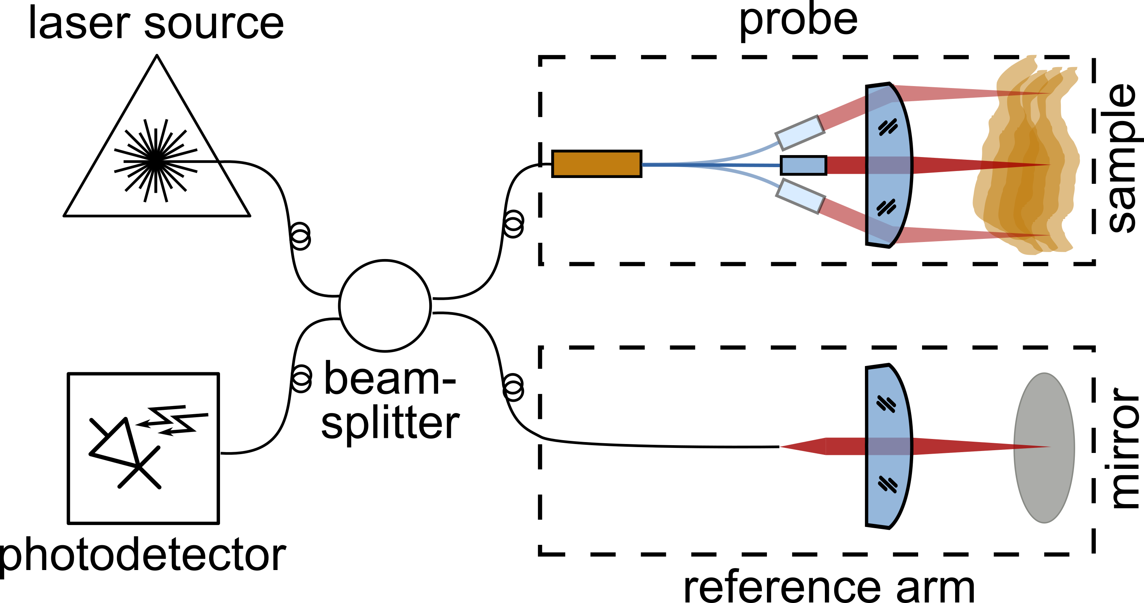
Swept-Source OCT: Fiber scanner requirements
Optical requirements:
Long depth of field: > 2 mm
Scanning mechanism
High field of view
Mechanical requirements:
Diameter < 3.3 mm
Scanning mechanism adequate for OCT sampling rate (100 kHz)
Object-side telecentric
Notes:
OCT systems endoscopy: fiber based
Same components but now probe goes into body
Practical requirements: Low NA 0.02

Slide 7
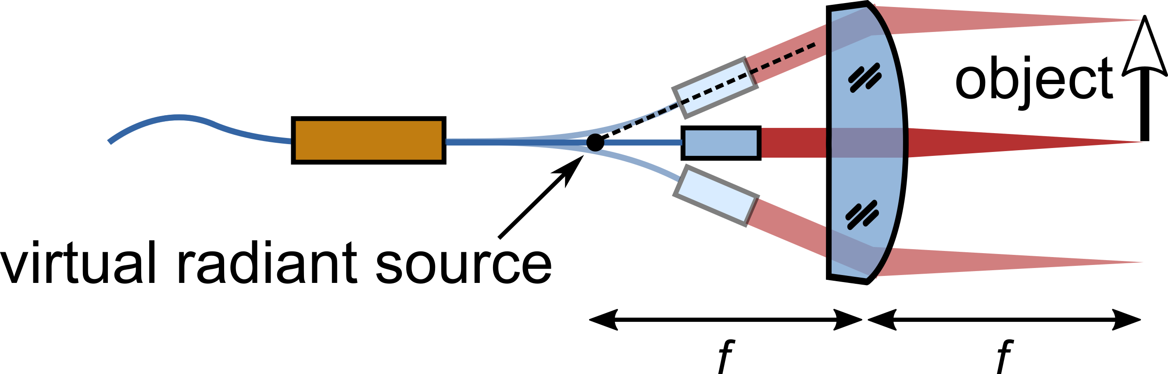
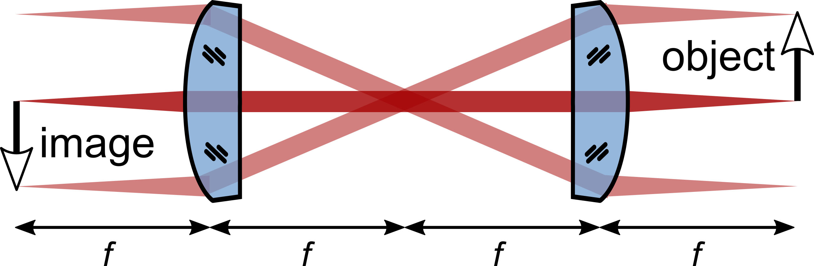
Fiber scanner Fourier plane scanner
Fourier plane
Notes:
Chosen implementation: Fourier plane scanner
Developed by Eric Seibel 2000
Intermediate region of a conventional microscope
Emulate this behavior by collimated light at an angle
-> How to achieve this behavior?
[Remove dashed angled line]

Slide 8
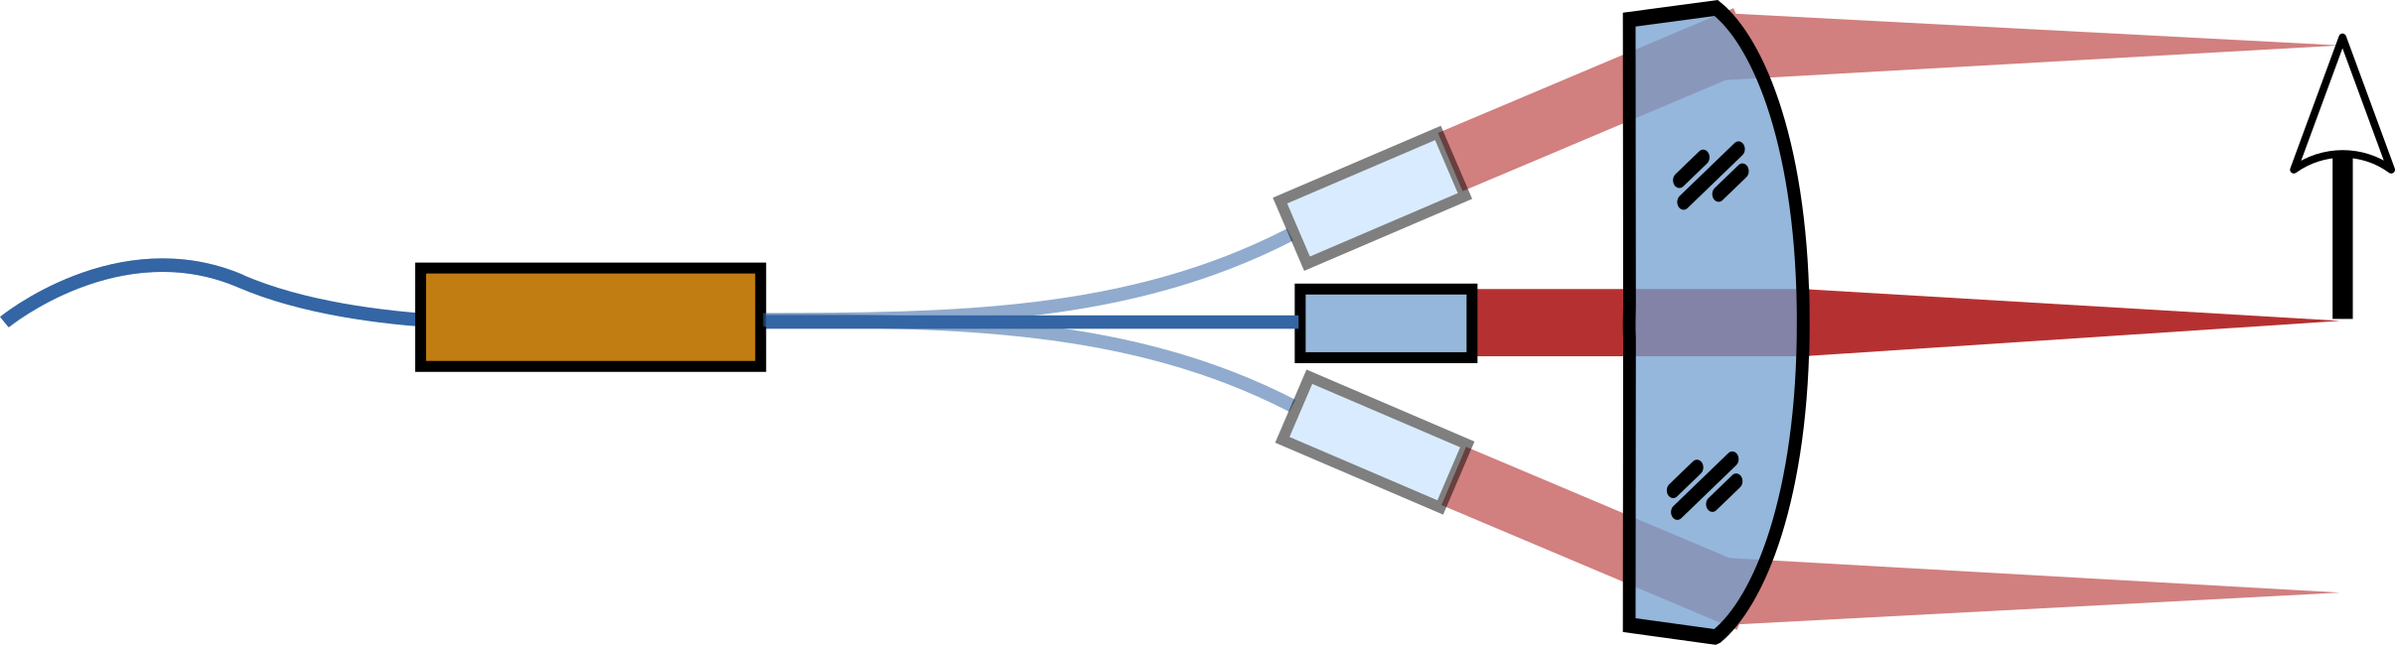
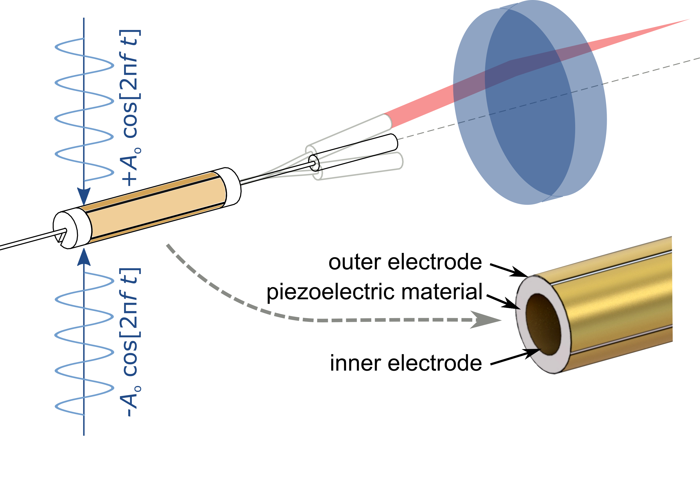
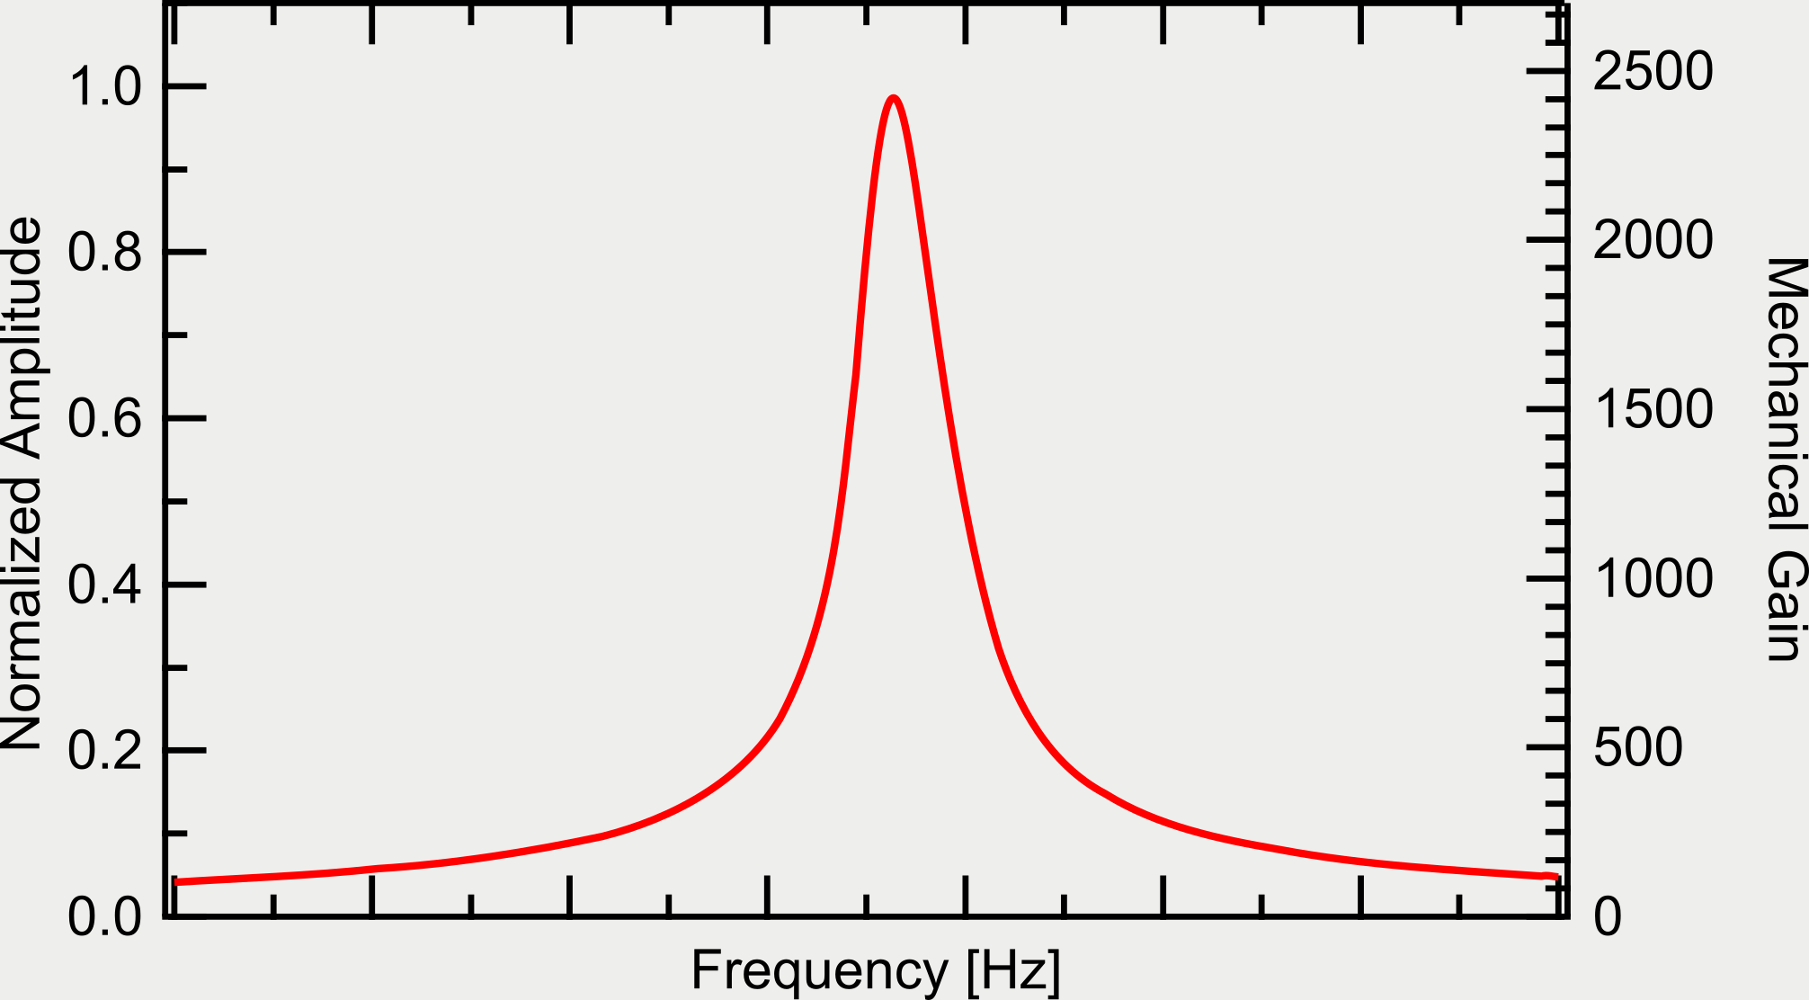
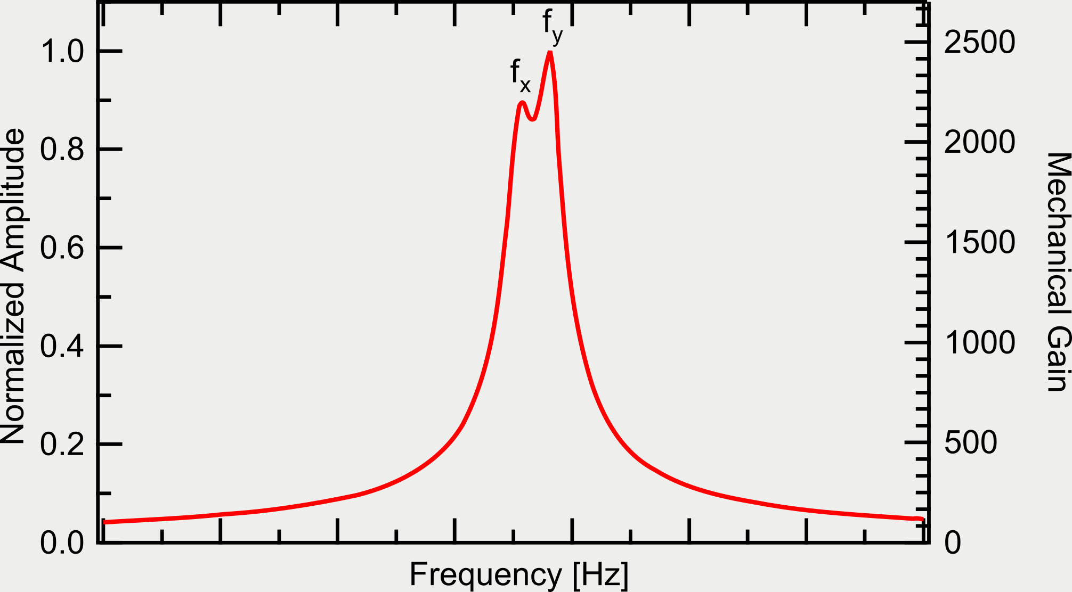
Fiber scanner Piezoelectric actuation + Mechanical amplification
Notes:
Piezoelectric actuation + Mechanical amplification
Piezoelectric tube: 4 electrodes, fixed at base
Excites a cantilever formed by fiber+GRIN
Sinusoidal excitation at fres -> 1000x mechanical gain
-> Lower fres as much as possible: analytical calculation

Slide 9
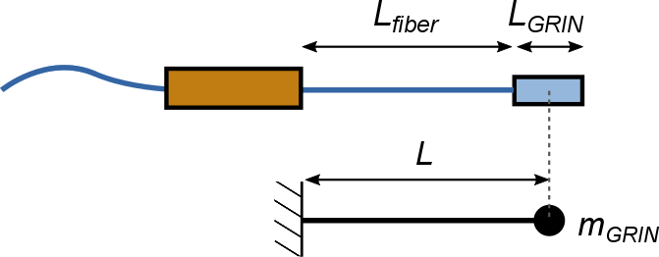
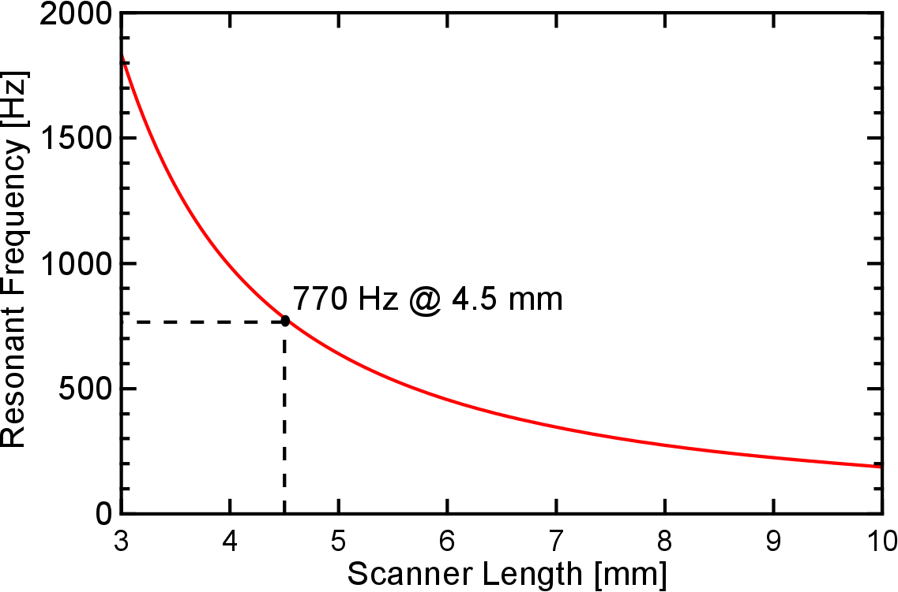
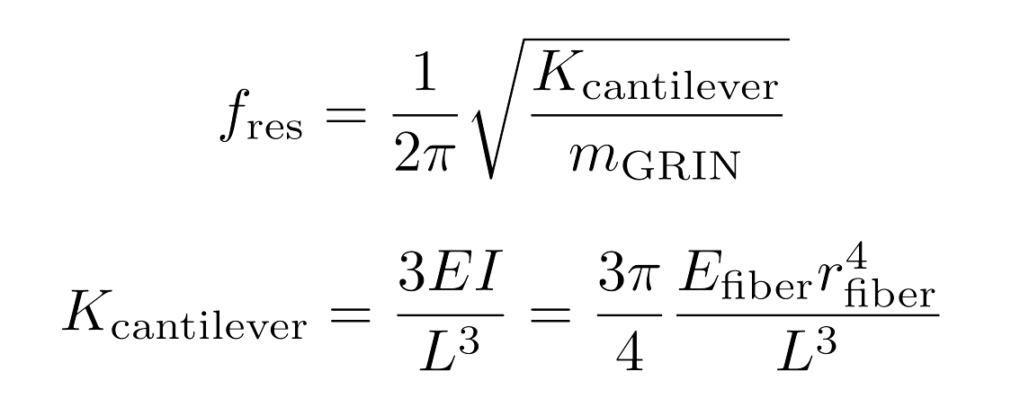
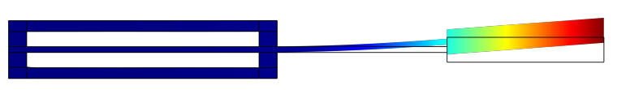
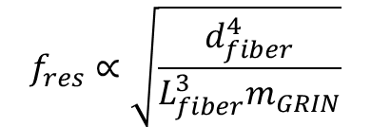
Fiber scanner Resonance frequency estimation
Analytical Calculation
770 Hz
COMSOL Simulation:
762 Hz
$$f_{res}∝\sqrt{\frac{d_{fiber}^{4}}{L_{fiber}^{3}m_{GRIN}}}$$
Notes:
Estimation by modelling the GRIN as point weight
Dependance: Dfiber, length, mas
-> Optical analysis of the scanner

Slide 10
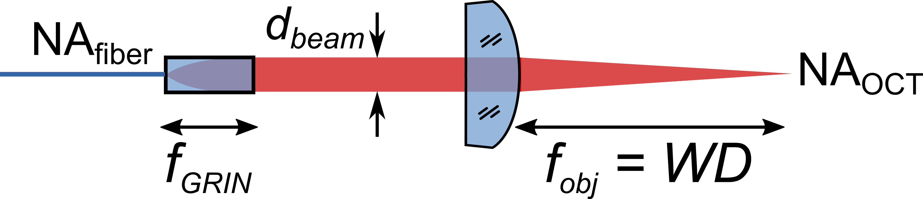
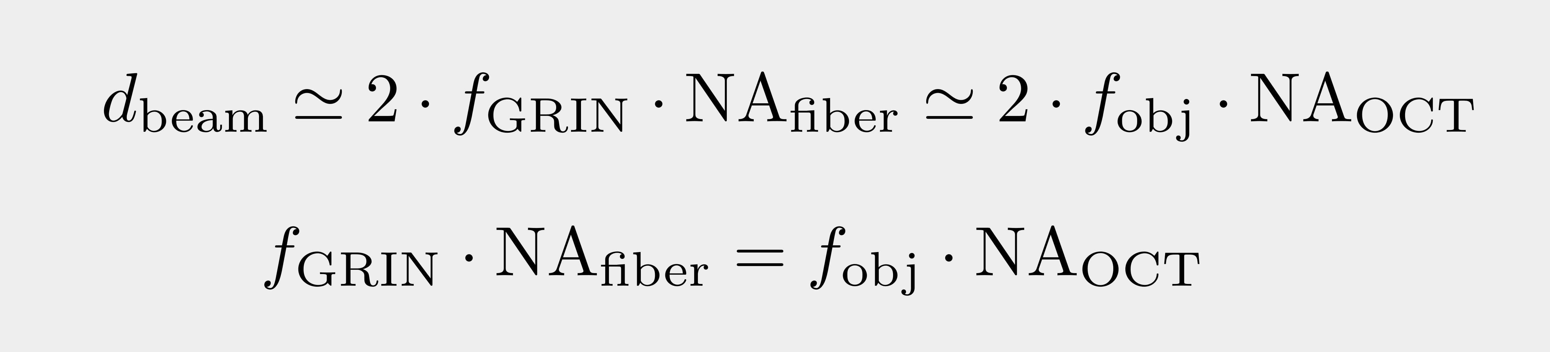
Optical performance Geometrical optics
Parameter | Value
NAfiber | 0.18
fGRIN | 0.91 mm
dbeam | 0.3 mm
fobj | 7.5 mm
NAOCT | 0.022
Notes:
Geometrical optics:
Interrelated parameters
Set NA
Calculate resolution of such system
OCT: Illuminate with laser, collect light

Slide 11
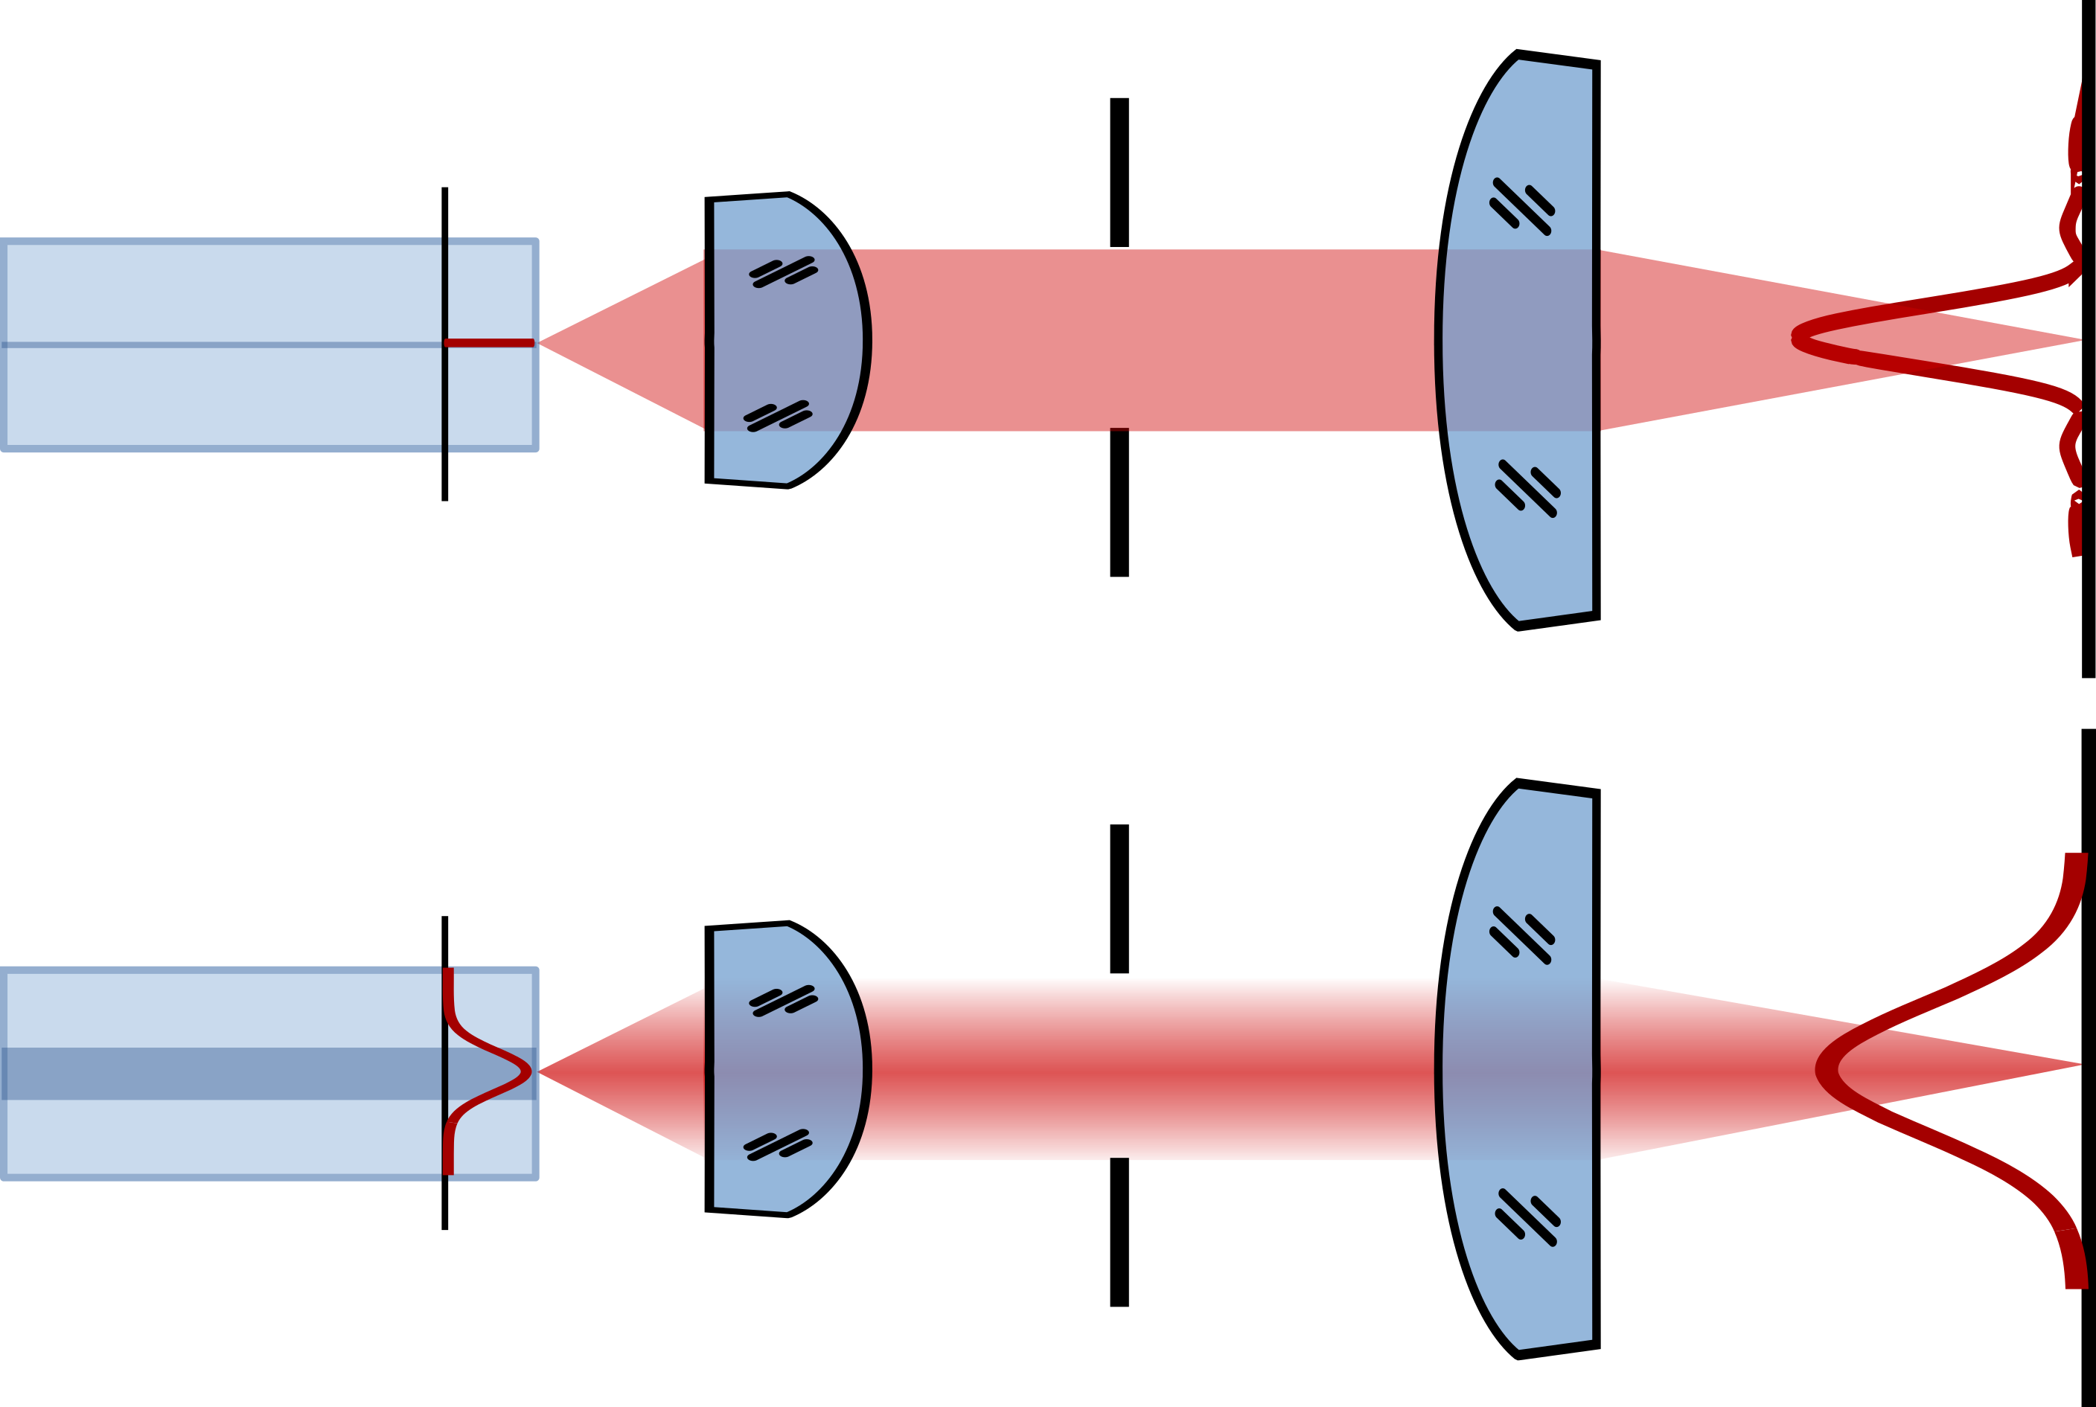
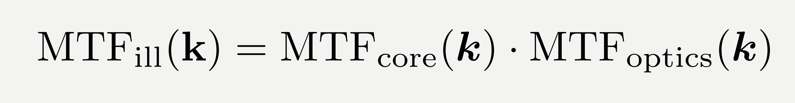
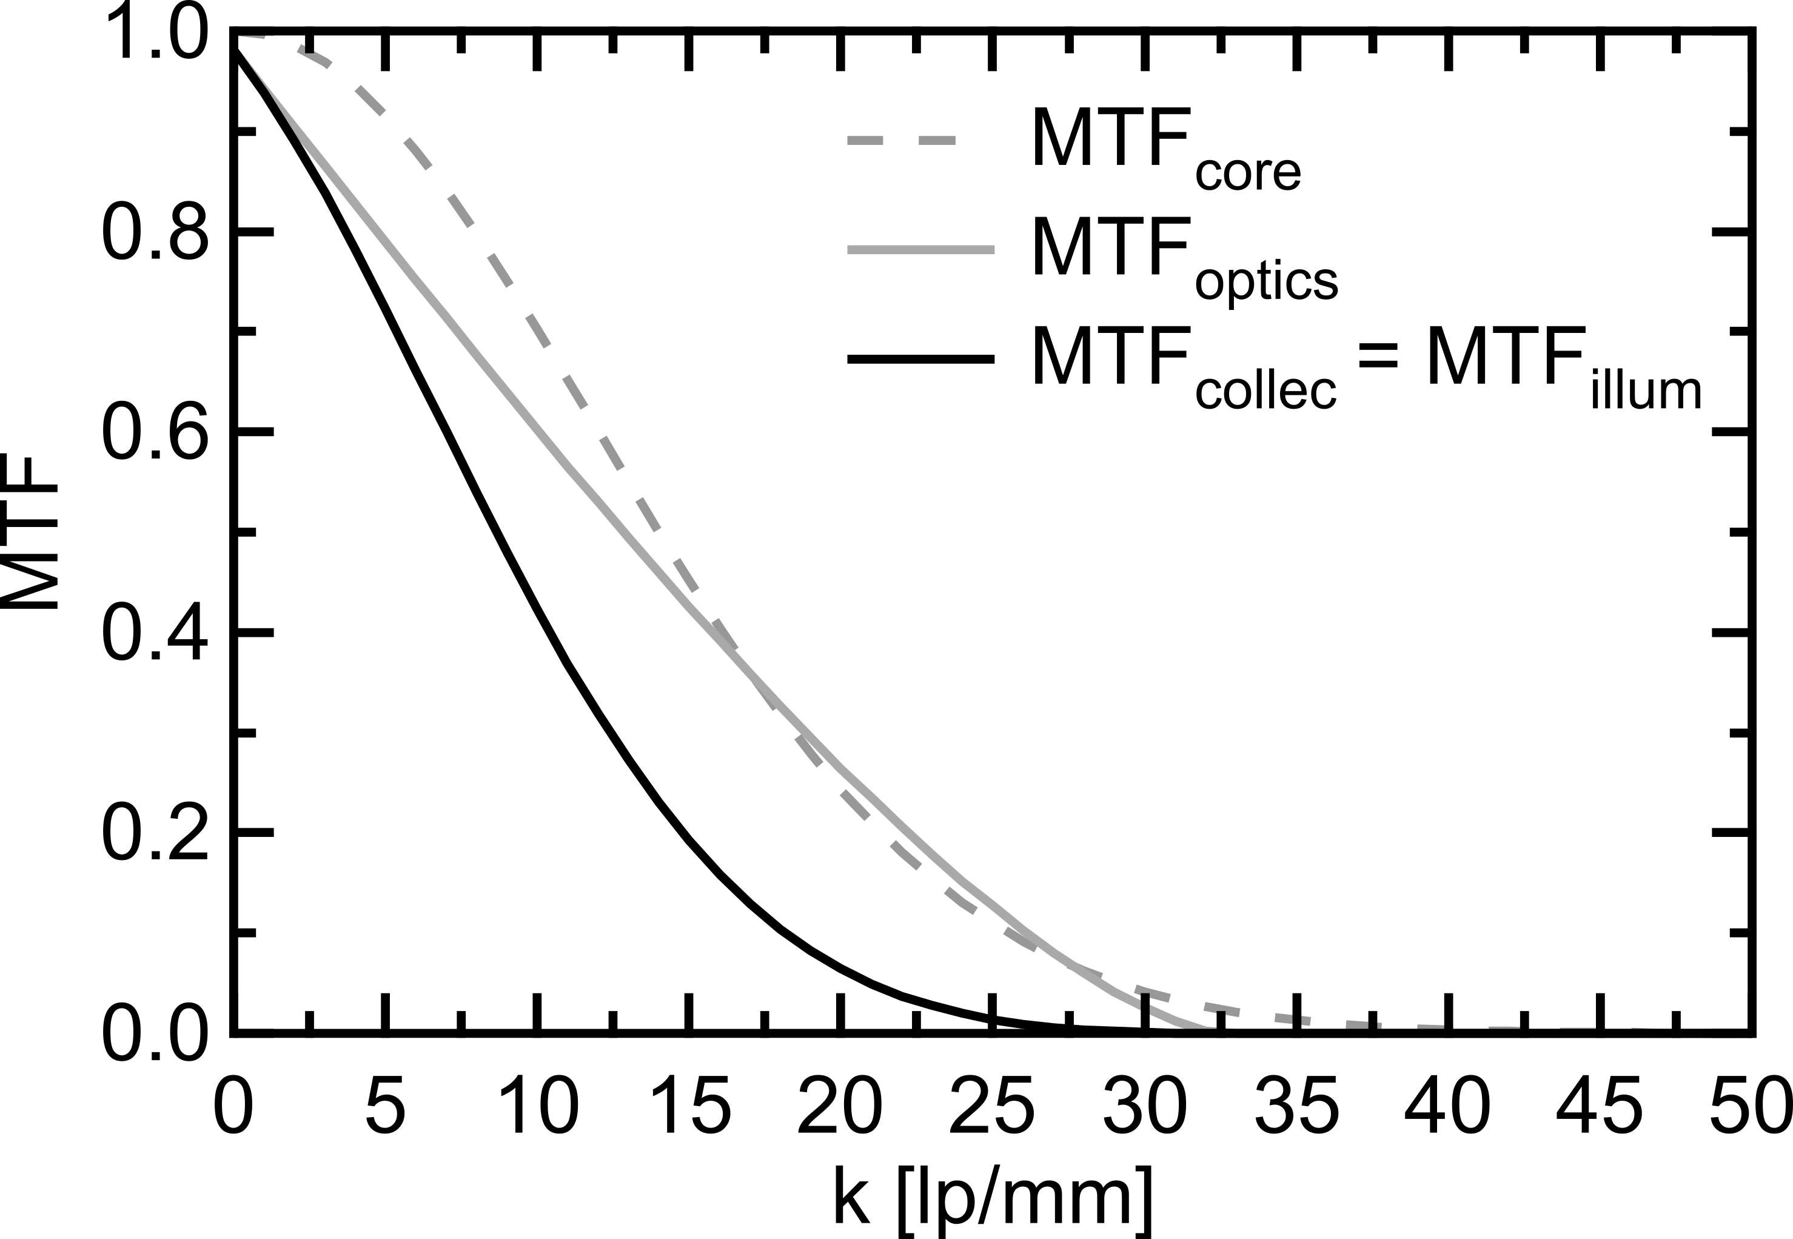
Optical performance Fourier optics: illumination PSF
Infinitesimal fiber core
Gaussian mode fiber core
Notes:
Start considering illumination: projector
Fiber - lens - aperture – sample
If fiber is point source – PSF shape defined by optics (NA), beam diameter
If fiber has an extended mode shape: convolution of
-> What happens with backscattered light?

Slide 12
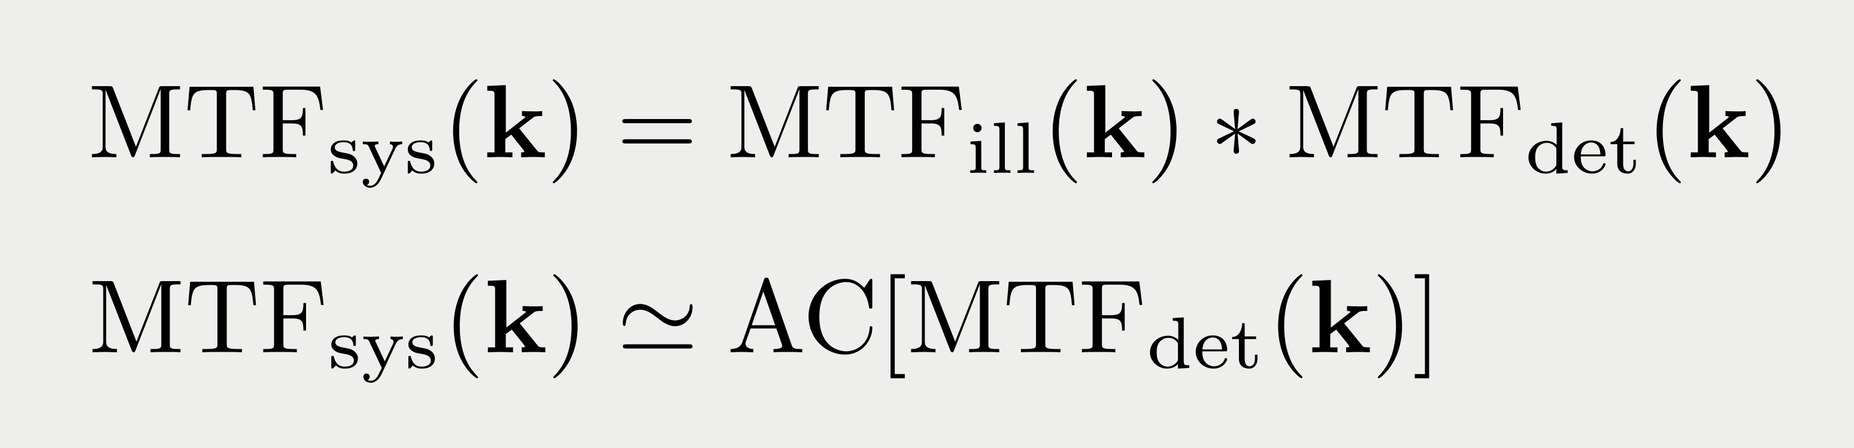
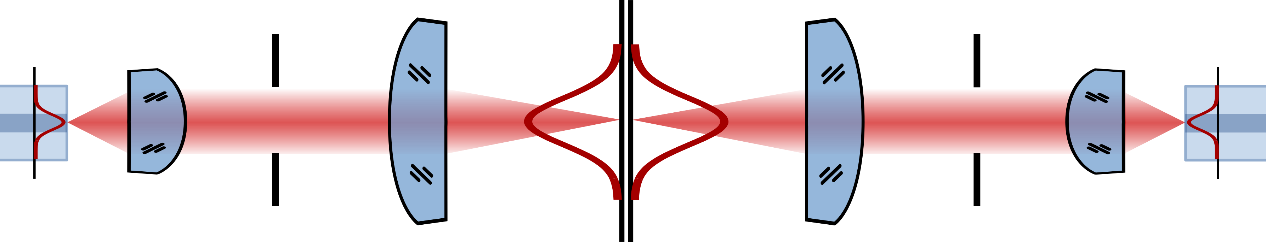
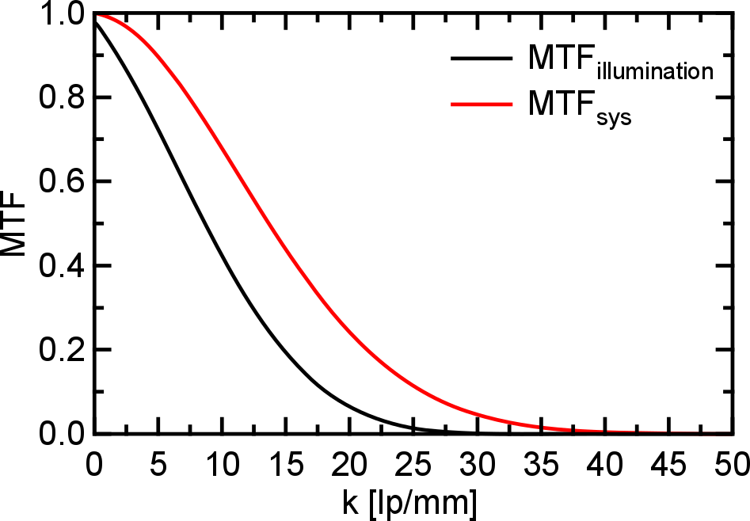
Optical performance Fourier optics: illumination + collection
illumination
detection
23.3 lp/mm
43 µm
Notes:
Helmholz reciprocity: Folded optical system
In order that photon reaches the detector:
Illuminate inside PSFill
Be accepted into the optical system
Same PSF squaring
Squaring of PSF – Autocorrelation of MTF
-> Simulation of this behavior

Slide 13
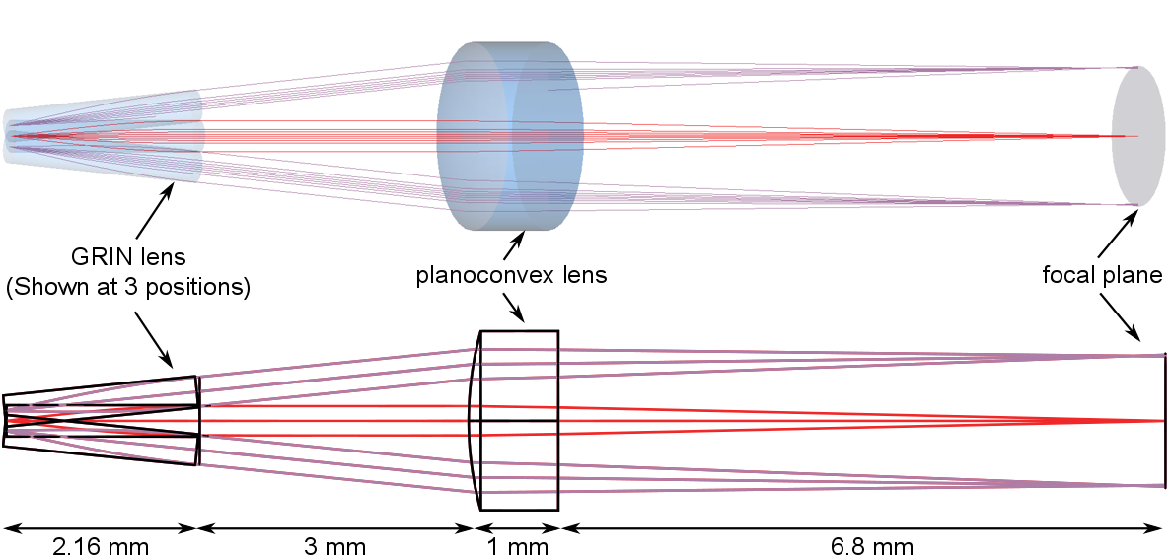
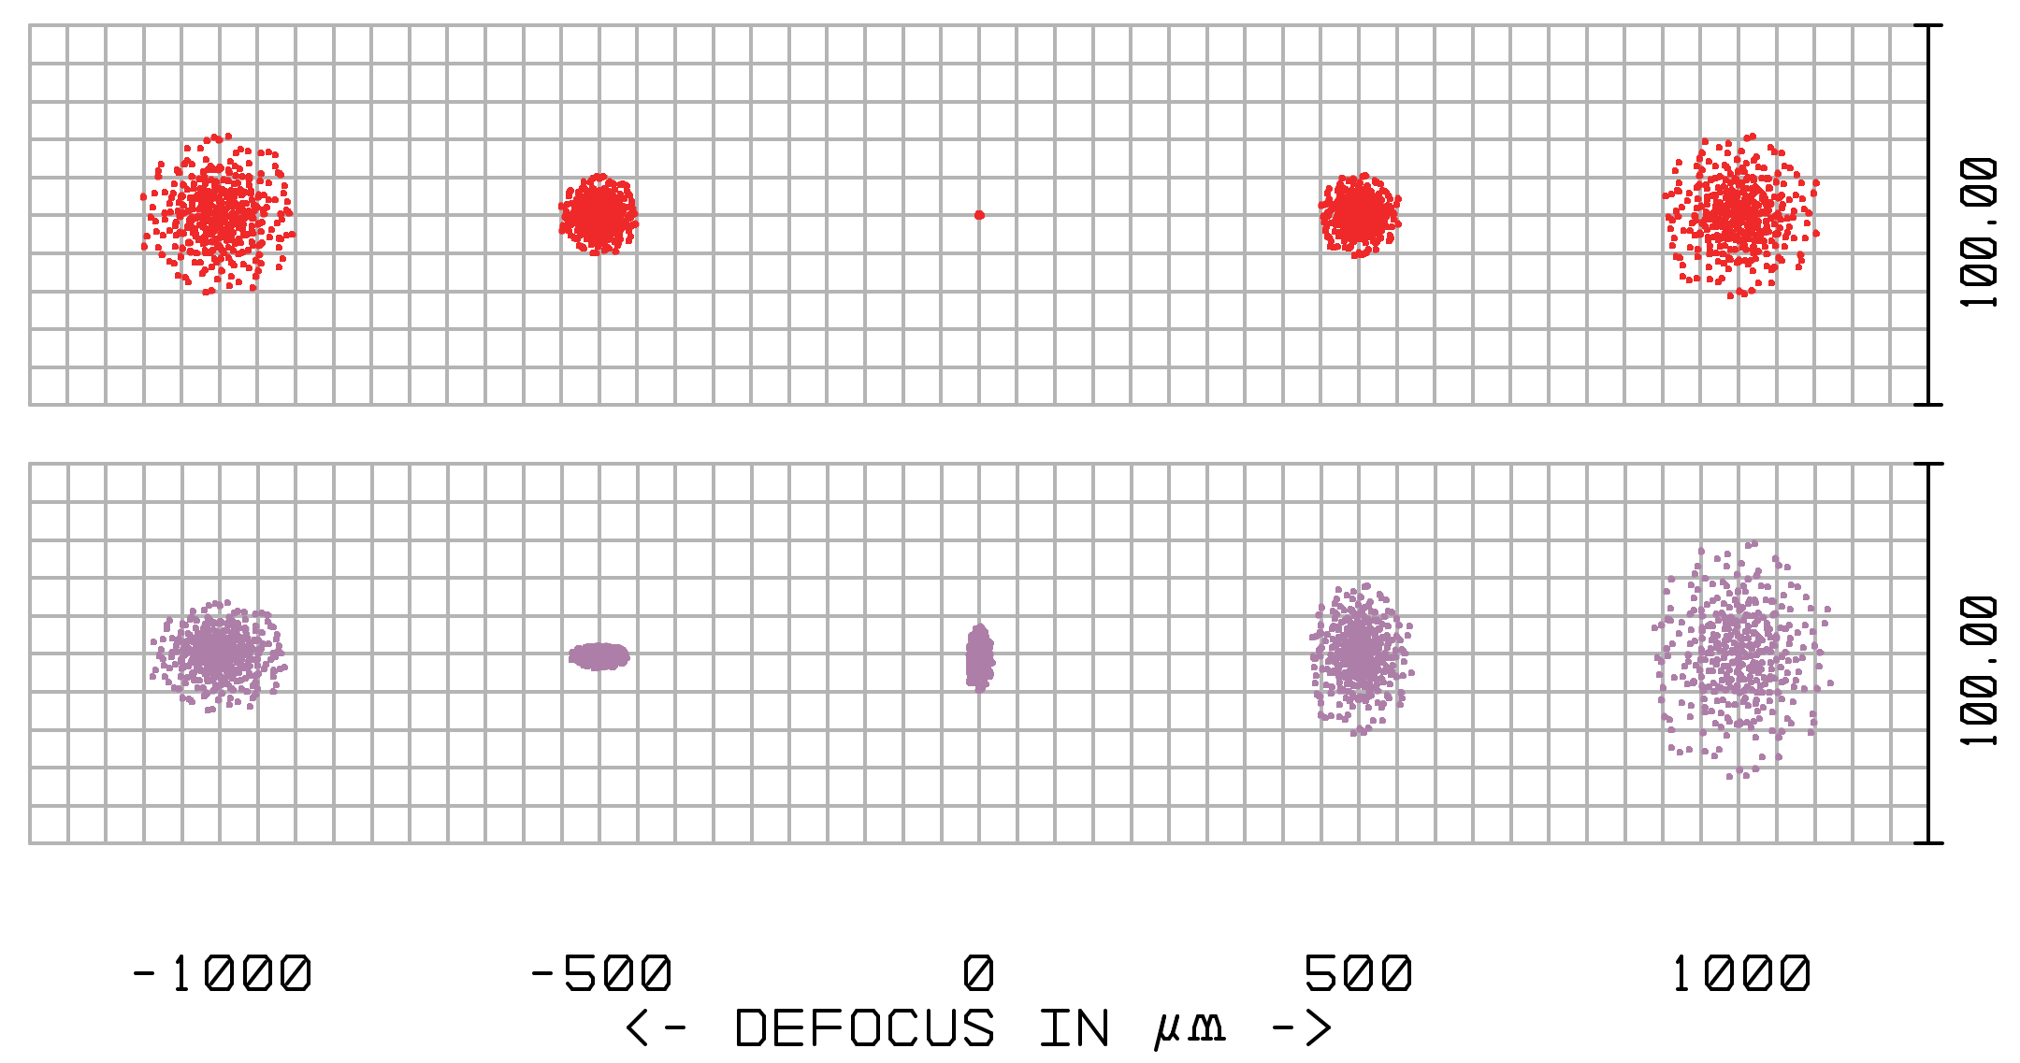
Optical performance ZEMAX simulation: Geometrical raytracing
raytracing
spot through focus
1.2 mm
Notes:
Different fields
Spot through focus
Aberrations
Low NA
1.2 mm FOV
-> Analyzed, simulated -> Test its behavior

Slide 14
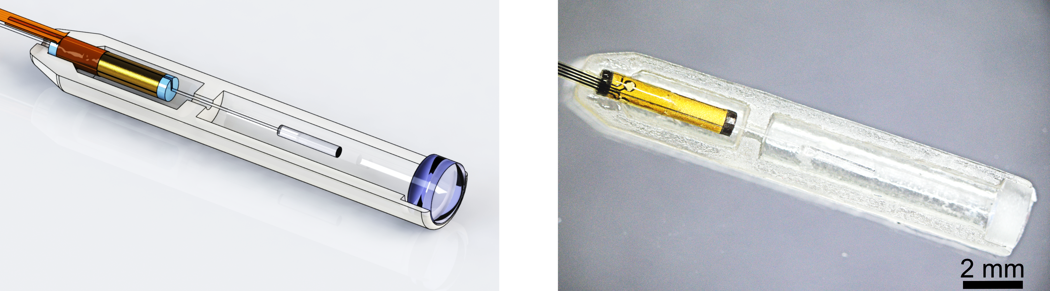
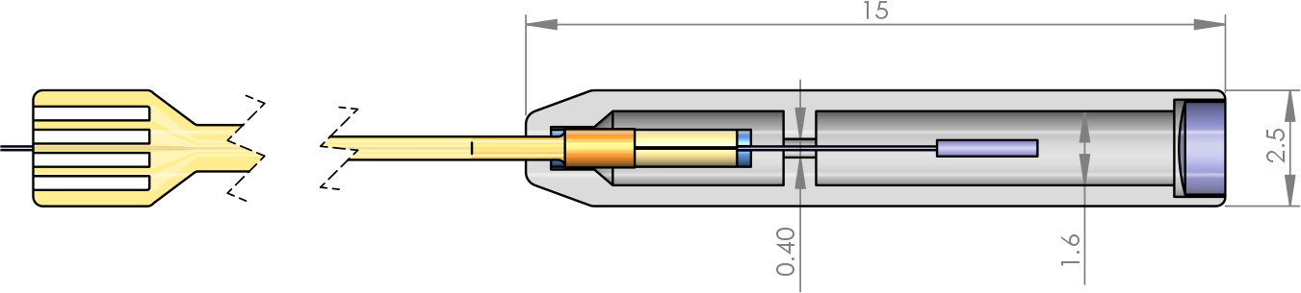
Implementation Single modality probe
Notes:
Implementation of single modality, OCT probe
Equivalent optics, mechanics
3D printed housing
Custom PI interconnects

Slide 15
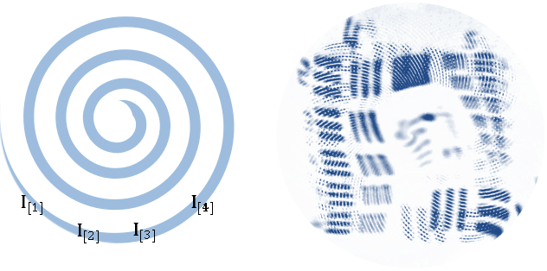
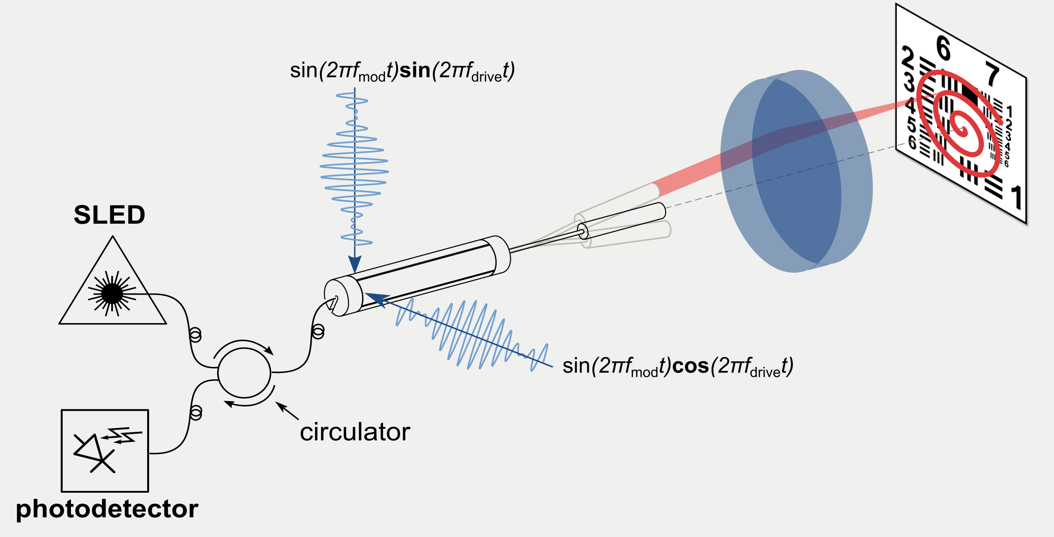
Experimental evaluation Laser scanned imaging
1.2 mm
Notes:
Experimental evaluation: Obtain Laser Scanned Images
Measure intensity of backreflected light
Setup
2D area: spiral scanning
FOV

Slide 16
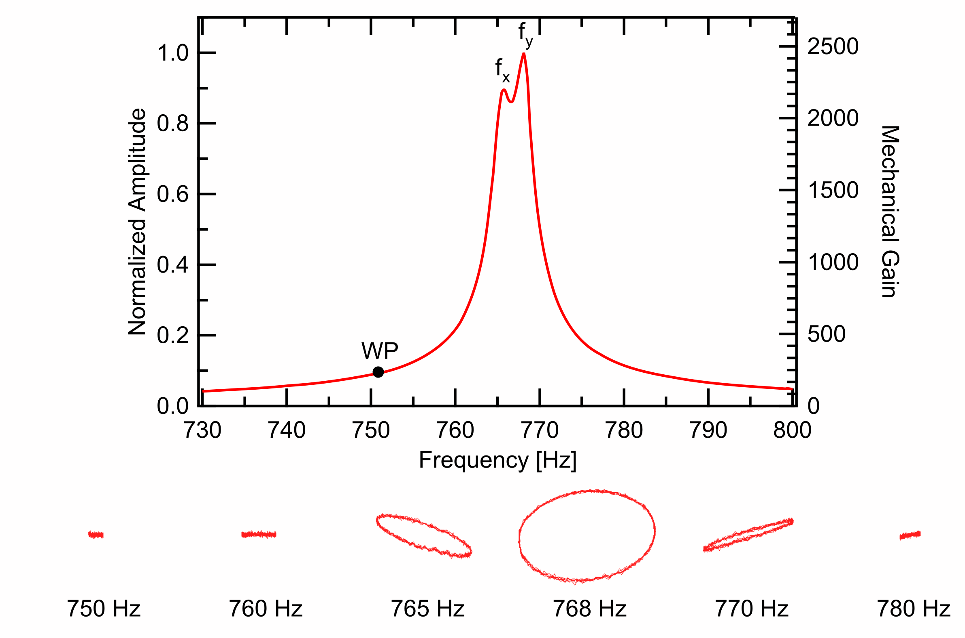
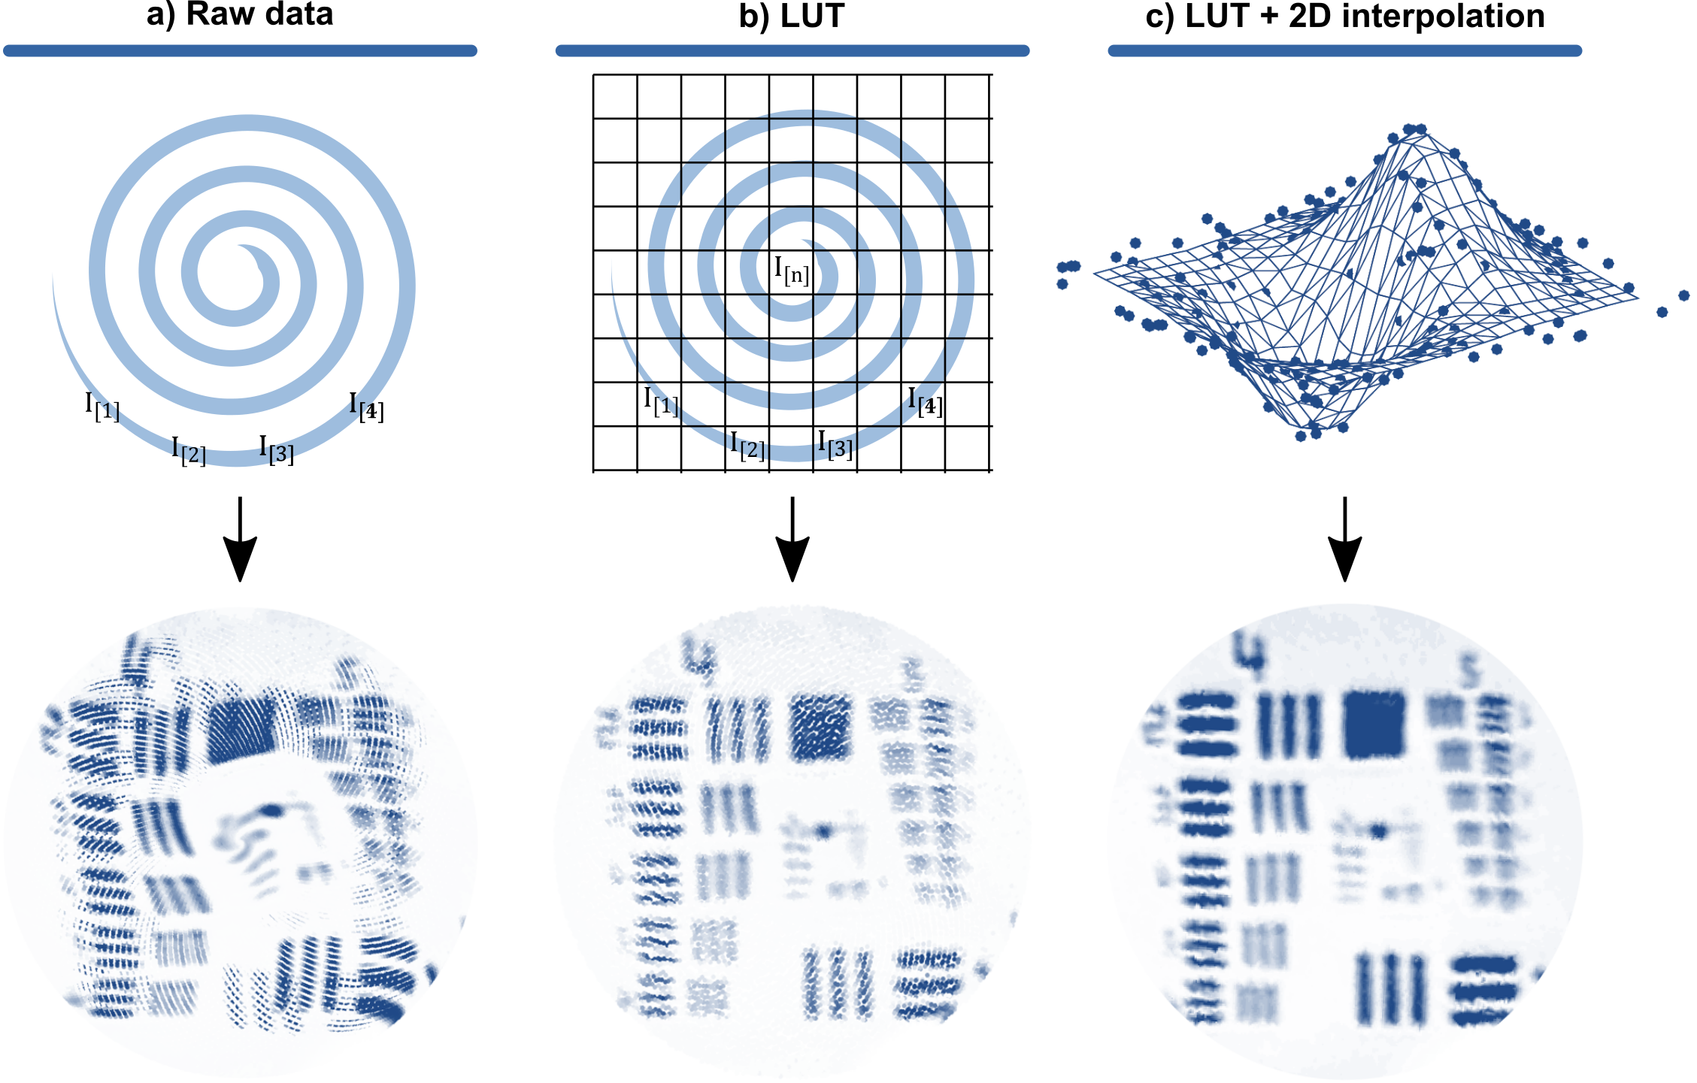
Experimental evaluation Distortion correction
Whirl patterns
Distortion Correction
Notes:
Distortion:
Non ideal beam: 2 axes of symmetry: eigendirection
Cross coupling of energy between them
Whirling
Solution:
WP far from resonance but enough gain
Look up table measured with PSD

Slide 17
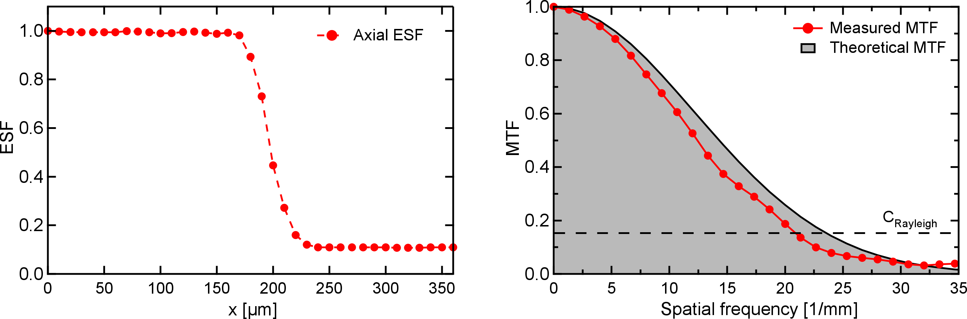
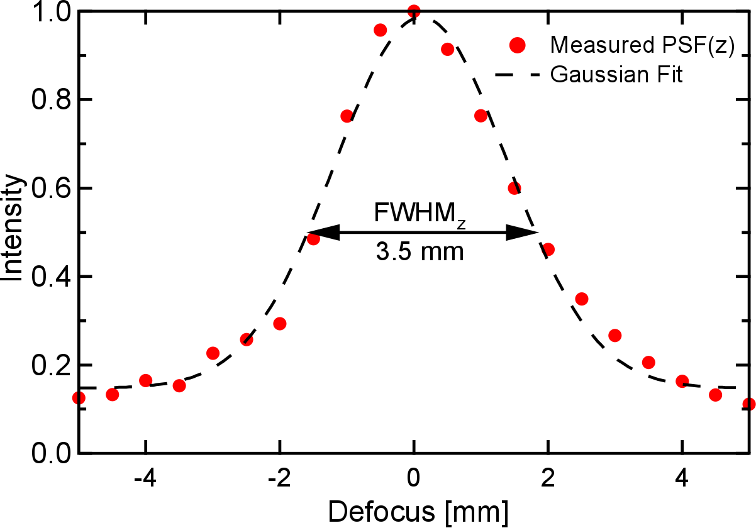
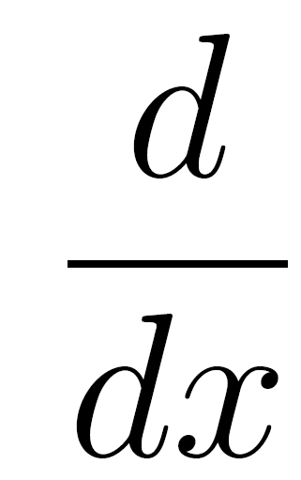

Experimental evaluation Resolution and field of view
Lateral resolution: 48 µm
Depth of Field: 3.5 mm
Edge Spread Function
,
MTF
Translated mirror
Notes:
Evaluate resolution:
Lateral resolution:
Edge (derivative) PSF (fourier) MTF

Slide 18
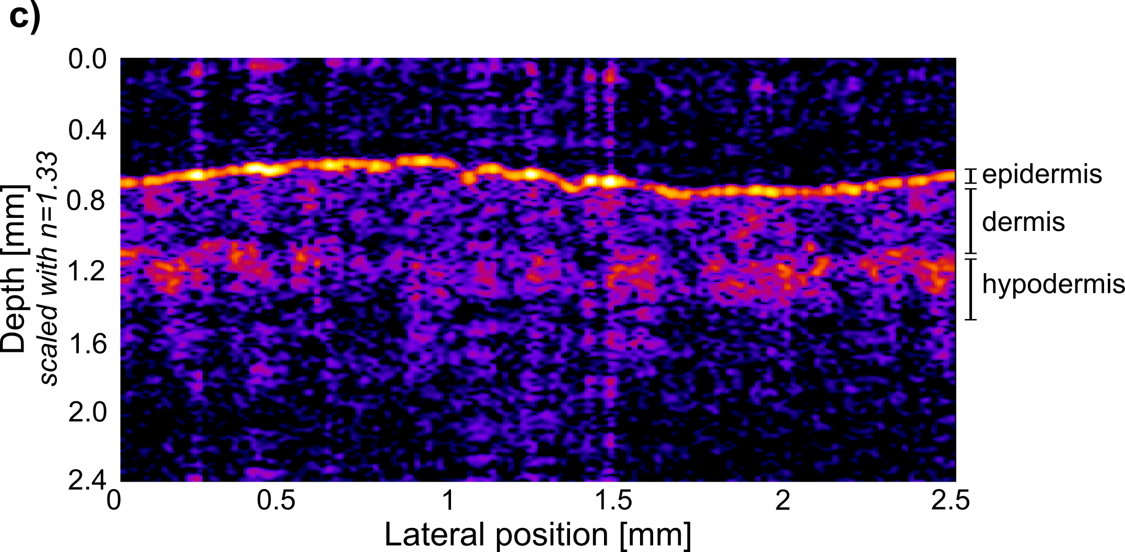
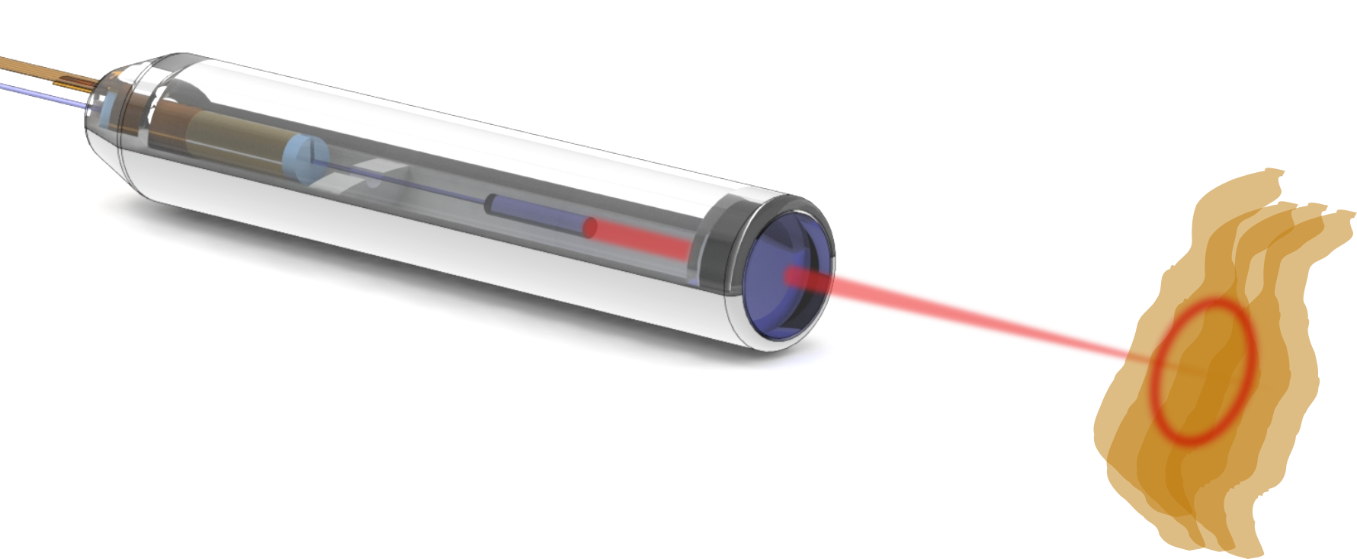
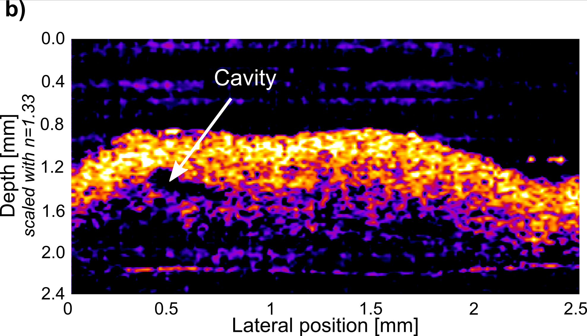
Experimental evaluation OCT cylindrical cross section imaging
Human fingertip
Human colon polyp

Slide 19
Conclusion and Outlook OCT 2D Imaging
OCT scanning engine: 0.9 mm diameter, 9 mm length
→ Smallest in literature?
Accurate optical and mechanical analytical analysis
→ Guideline for future fiber scanner systems
Reduction of imaging distortions
Outlook: Integration in bimodal probe

Slide 20
Compact OCT scanner for a bimodal endoscopic probe
Sergio Vilches

Slide 21
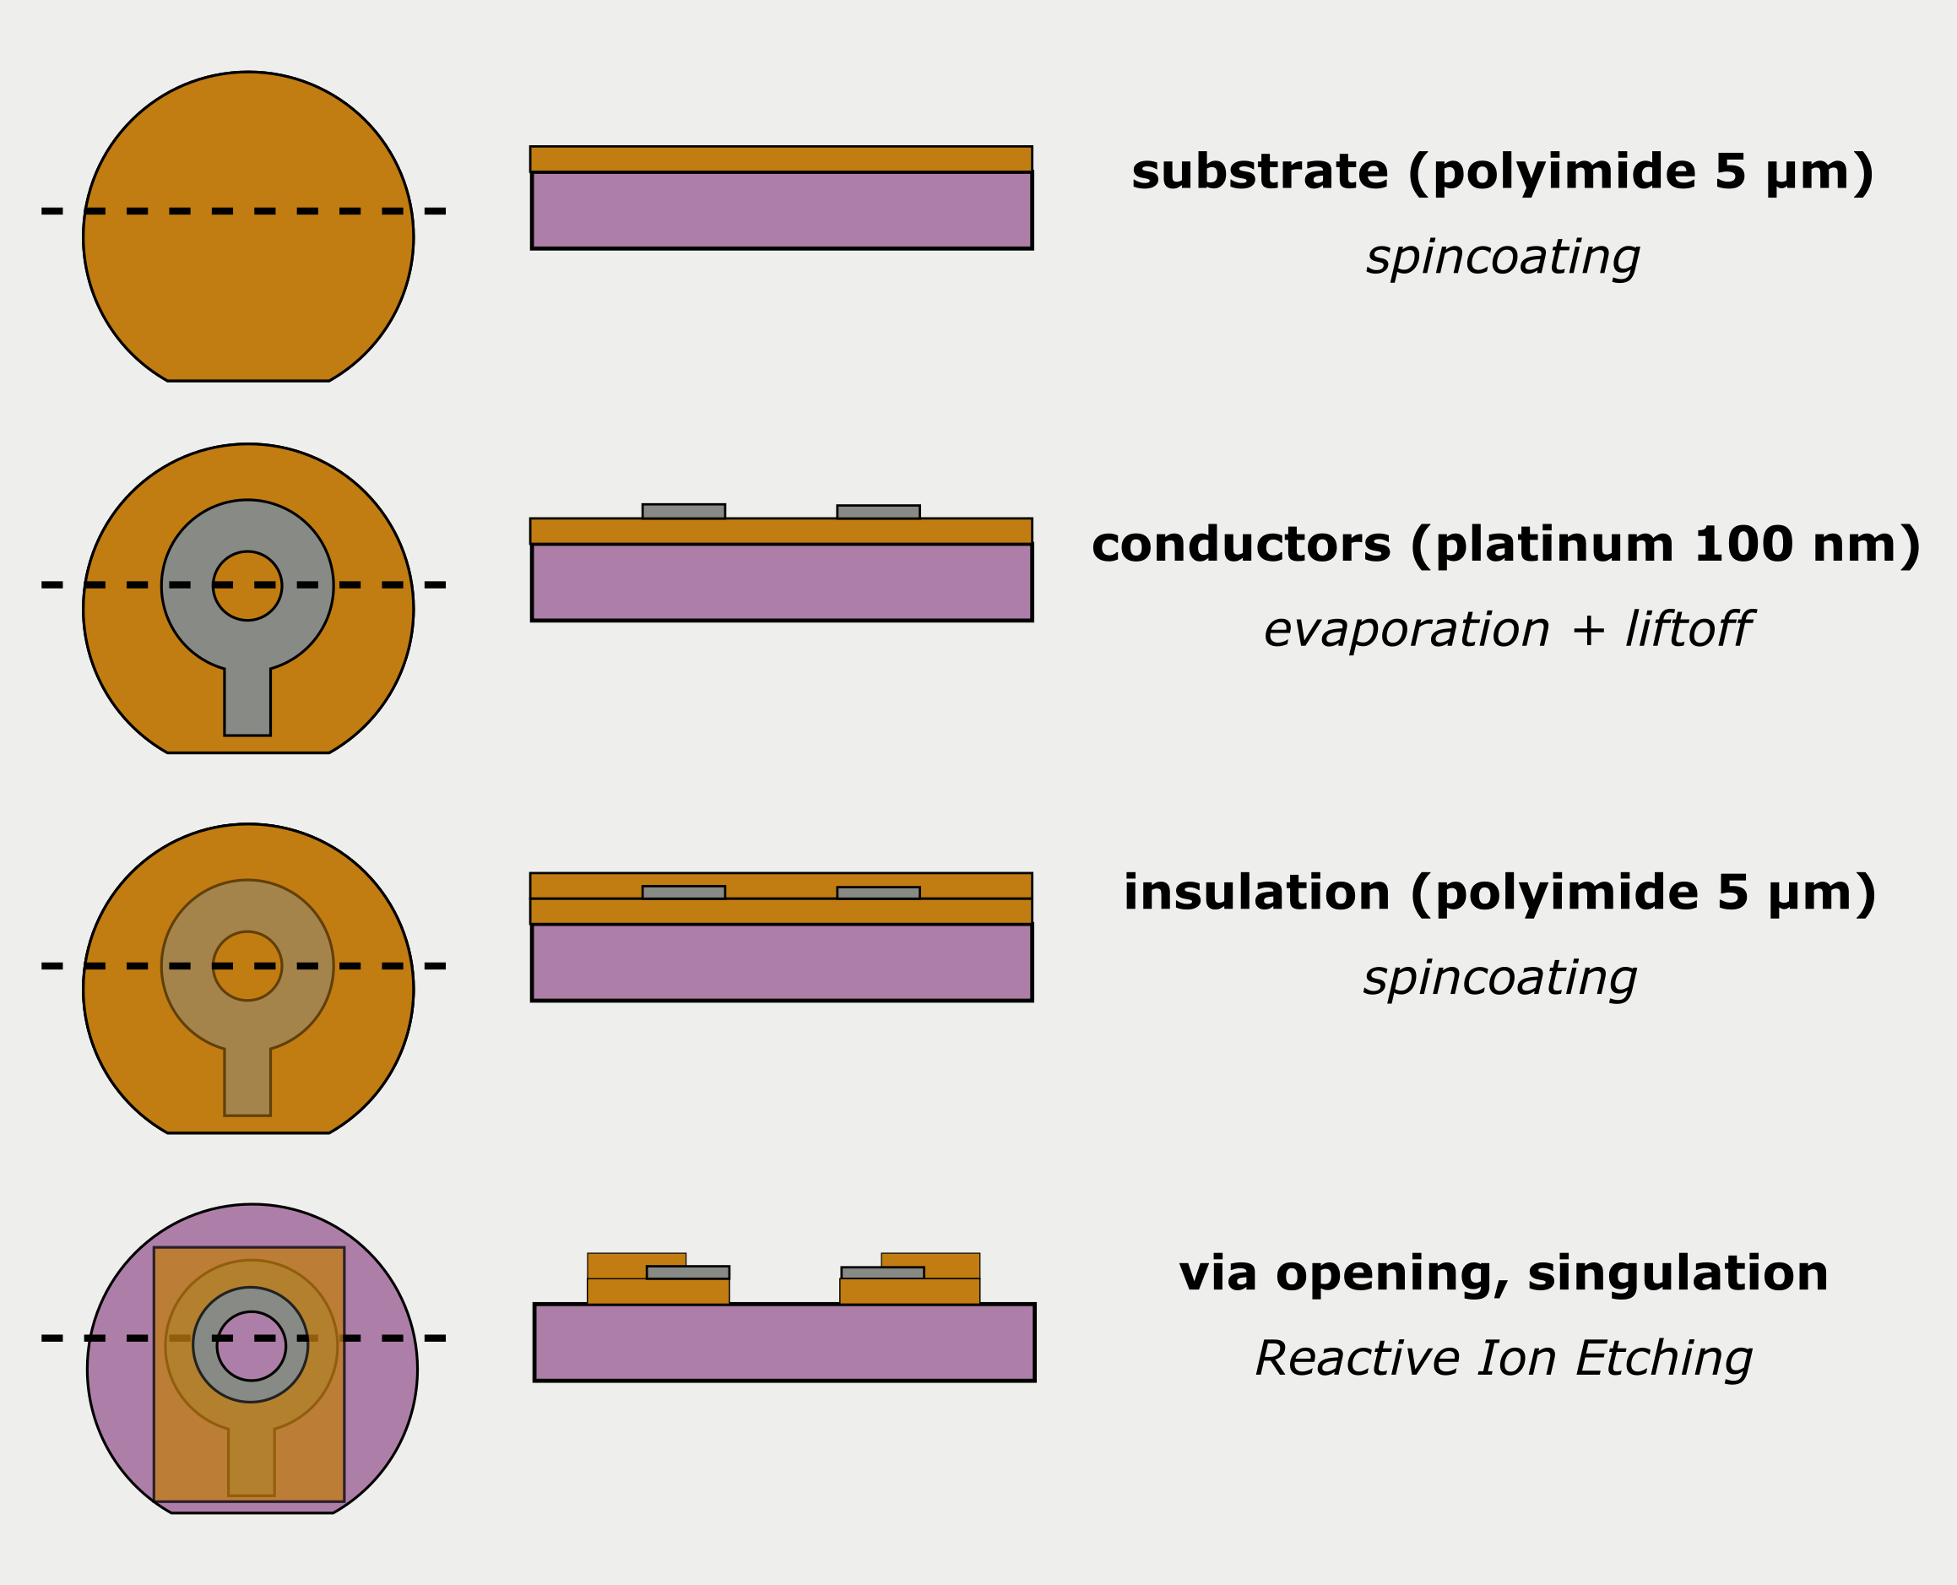
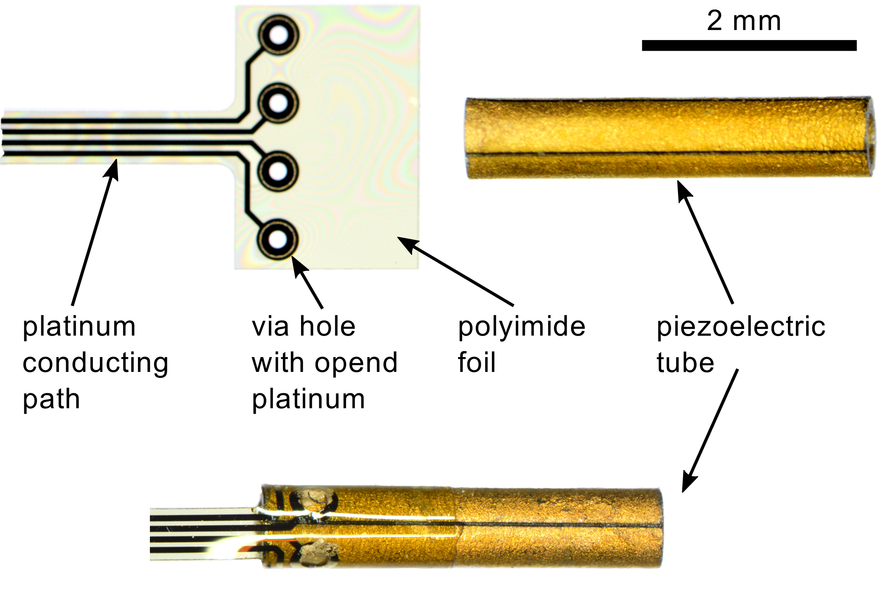
Implementation Electrical contacts

Slide 22
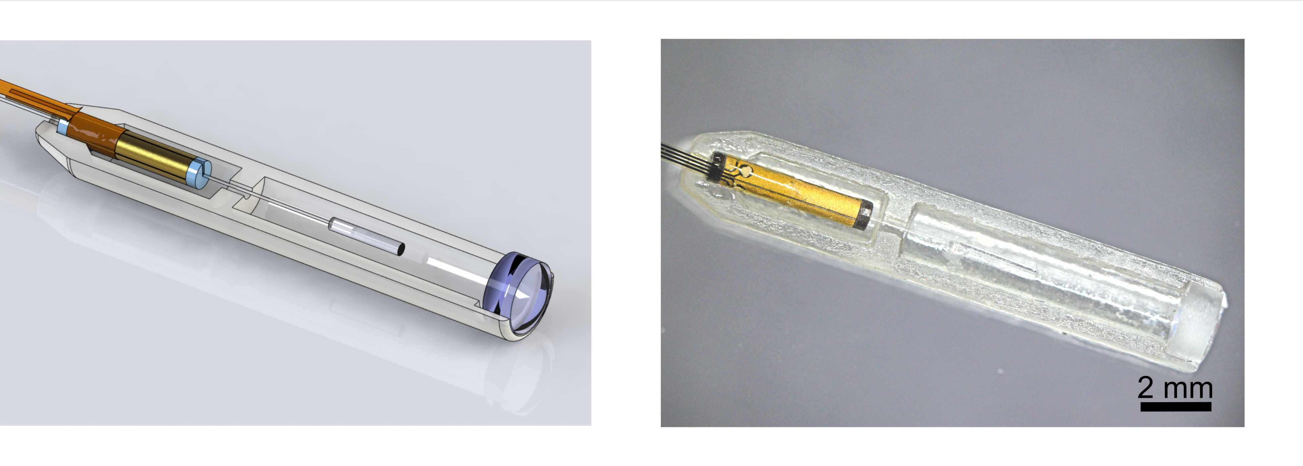
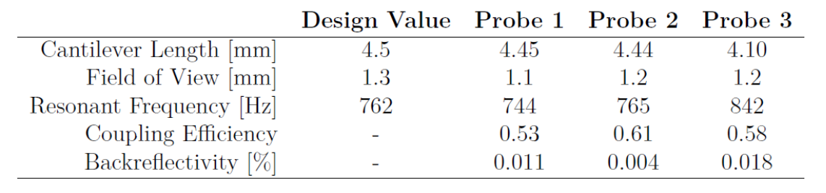
Implementation 3D printed housing

Slide 23




Motivation Bimodal Endoscopy
Arteriovenous Malformation
Fujii T. Kuwano H.
microscopy
OCT
+
Transversal OCT image of the macula J. A. Flatter and J. Carroll,
Notes:
Add 3.5 mm jack
Motivation: use several imaging modalities to improve diagnostic
Proposed endoscope head 13x2x3mm3
Aim of thesis: OCT modality
-> Review theory of OCT

